Slide 1
CS839: Modern Data Management and Machine Learning Systems
Lecture 1: Course Overview

Slide 2
A naïve ML workload

Slide 3
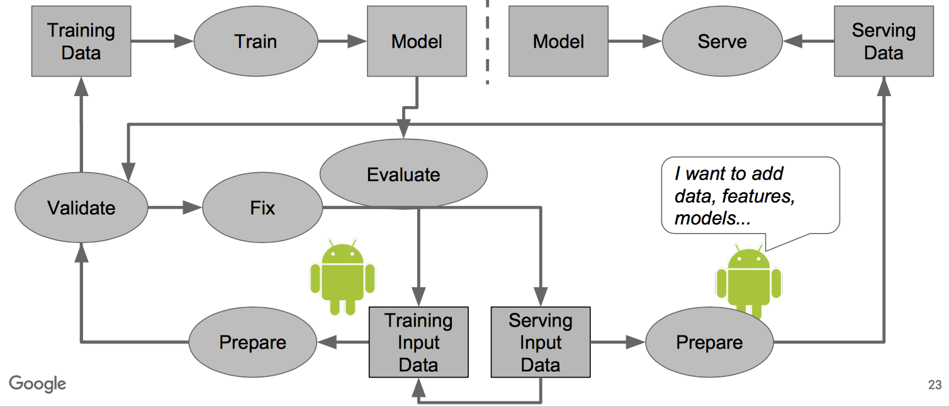
A real-life ML workload
Source: [Polyzotis et al., SIGMOD 2017]

Slide 4
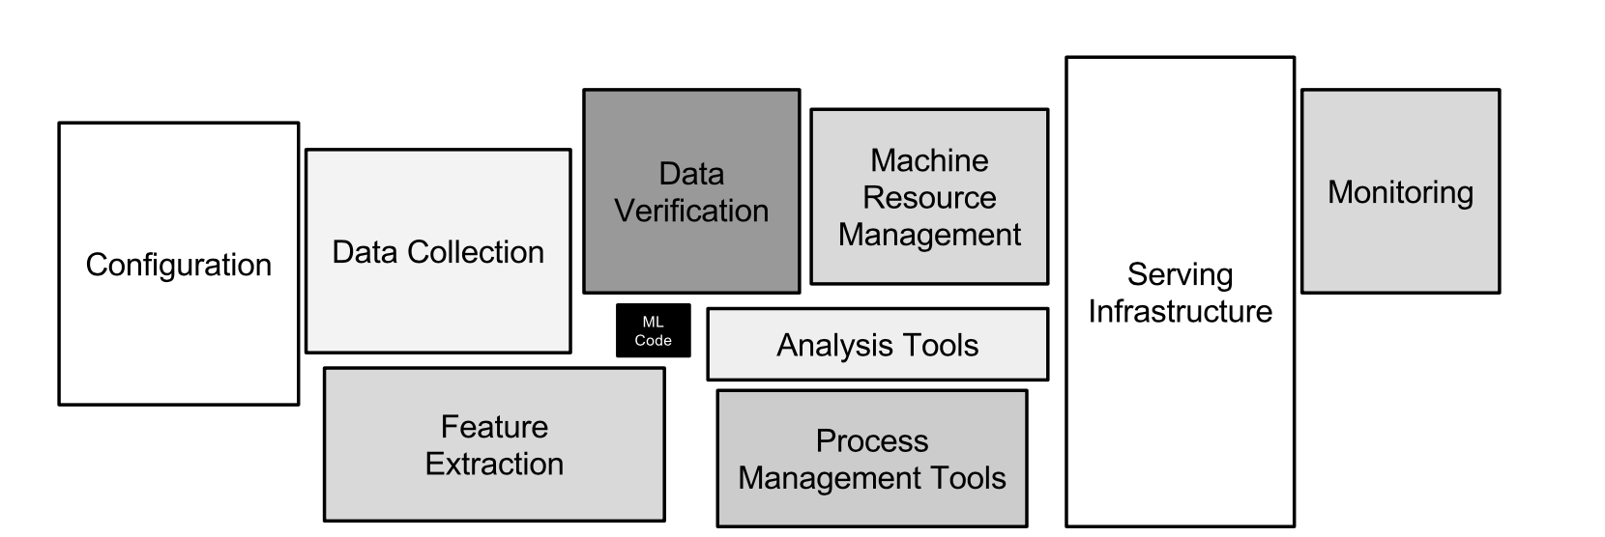
ML-related components in real-life

Slide 5
Today’s Lecture
Introduction, Admin & Logistics
Course Overview

Slide 6
1. Introduction, Admin & Logistics
Section 1

Slide 7
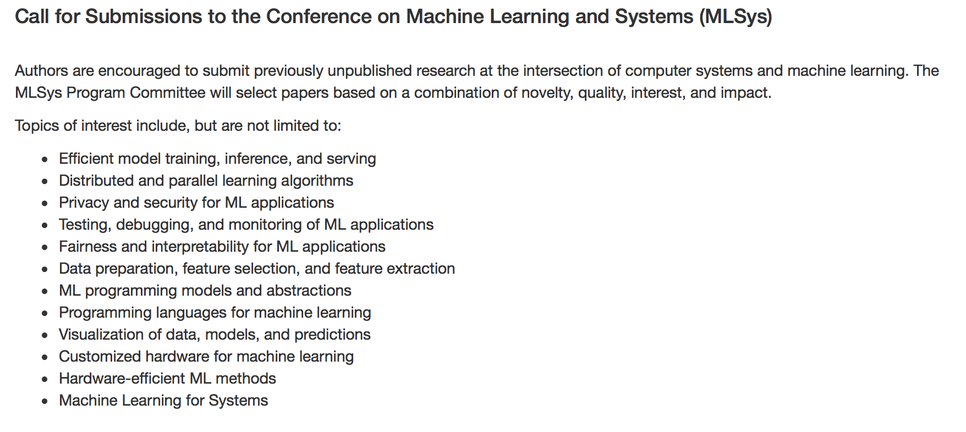
Why this class?
Section 1 > Introduction
Intellectual:
Combine ideas from CS, statistics, optimization, etc.
The coolest new thing!

Slide 8
Why this class?
Section 1 > Introduction

Slide 9
Why this class?
Section 1 > Introduction

Slide 10
Why this class?
Section 1 > Introduction

Slide 11
Why this class?
Section 1 > Introduction
Mercenary-make more $$$:

Slide 12
What this course is (and is not)
Section 1 > Introduction
Discuss data management and systems challenges at different stages of ML pipelines
How to collect data to be consumed by ML pipelines.
How to manage noisy data the data
How to serve ML models fast
Not how to be a Tensorflow ninja; not how to go into a Deep (learning) frenzy.
We’ll cover algorithms and systems
And explore how to build the next generation of data mangeent and ML systems

Slide 13
Who am I…
Section 1 > Administrative > Course Staff
Instructor (me) Theo Rekatsinas
Faculty in the Computer Sciences and part of the UW-Database Group
Research: data integration and cleaning, statistical analytics, and machine learning.
thodrek@cs.wisc.edu
Office hours: By appointment @CS 4361

Slide 14
Communication
Section 1 > Administrative
Via email: thodrek@cs.wisc.edu
By appointment!

Slide 15
Course Website: https://thodrek.github.io/cs839_sp20/
Section 1 > Administrative

Slide 16
Lectures and Readings
Section 1 > Logistics
Lectures split into weekly themes:
Two-classes per theme
First class: lecture by instructor (background and core-concepts)
Second class: paper review, presentation, and discussion
Each part covers one core topic in real-life ML deployments

Slide 17
Lectures and Readings
Section 1 > Logistics
One mandatory paper to read every week
10 papers in total
More papers posted for every topic; These will help you for your projects
How does this work:
We will ask for 10 volunteers to present the paper (discussion leaders)
The volunteers will give a 20 minute whiteboard talk on the paper
If we do not have enough volunteers we will select people at random
We will ask for 10 volunteers as scribes
The scribe will need to keep minutes and summarize the discussion around the paper
The presentation will be followed by a detailed paper discussion
All people but the presenter and the scribe are required to submit a conference-style review
The volunteer will not have to submit a review

Slide 18
Conference-Style Reviews
Section 1 > Logistics
Summary
3 strong points - 3 week points
Detailed comments
You need to read and understand the papers!

Slide 19
Graded Elements
Section 1 > Logistics
Reviews and Presentations (20%)
Project Presentation (20%)
Final Project Report (60%)
No exams or other homework

Slide 20
Research Project
Section 1 > Logistics
What can it be?
An open problem relevant to your research and the course
An open problem relevant to the course
Will post some suggestions later in the semester
Milestones
Part 1: Proposal (due 2/25); feedback the following week
Part 2: Final presentations on 4/28 and 4/30;
Random assignment
Part 3: Final report (due 5/8)
What is a good project?

Slide 21
What is expected from you
Section 1 > Logistics
Attend lectures
If you don’t, it’s at your own peril
Be active and think critically
Ask questions, post comments
Do an amazing project
Start early and push hard

Slide 22
Lectures Overview
Section 1 > Lectures
Machine Learning Life-Cycle
Training Data Collection
Data Validation
Adaptive Data Management
Serving Feature Selection Workloads
Automated ML
Distributed Model Training
Efficient Prediction Serving
Model Compression
Relational Bias in Neural Networks

Slide 23
Machine Learning Life-Cycle
Section 1 > Lectures
Source: [Gonzalez, IEEE Data Engineering Bulletin 2018]

Slide 24
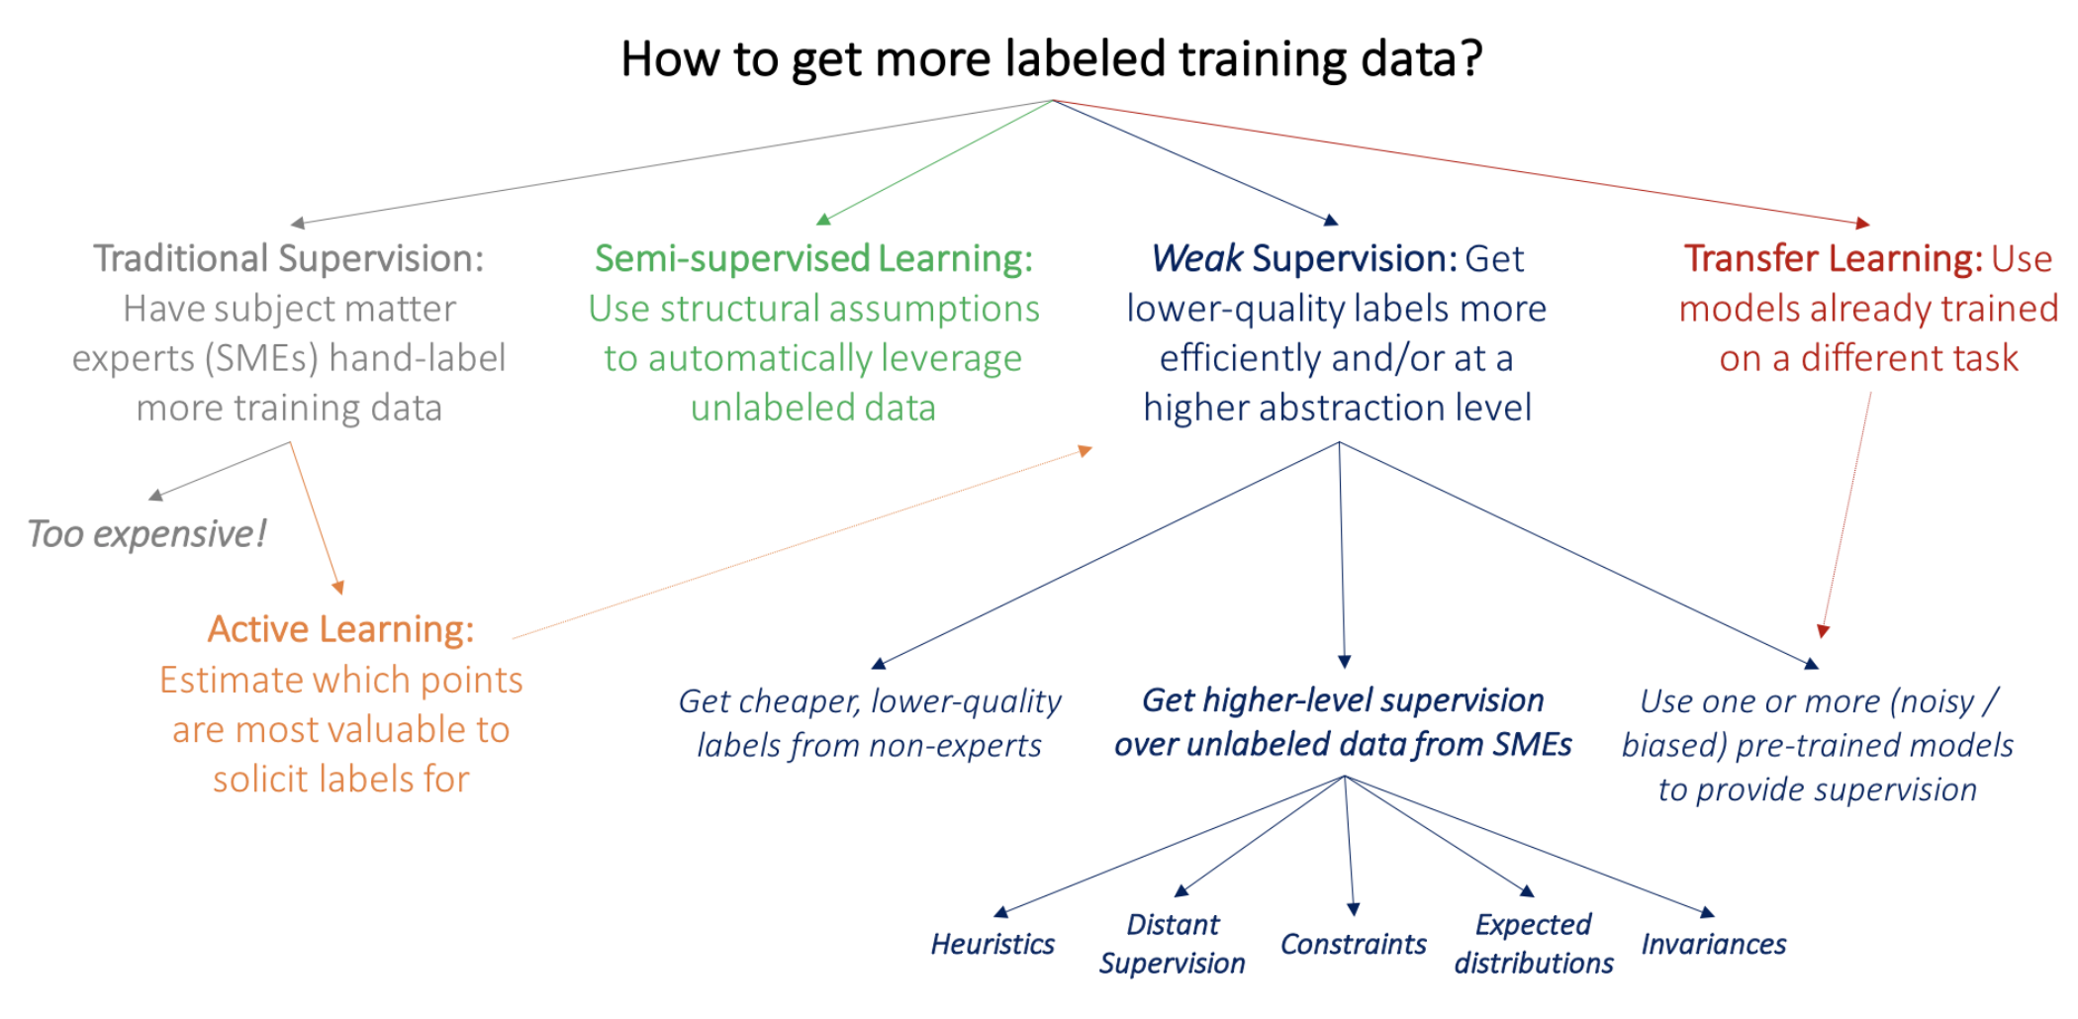
Training Data Collection
Section 1 > Lectures

Slide 25
Data Validation
Section 1 > Lectures

Slide 26
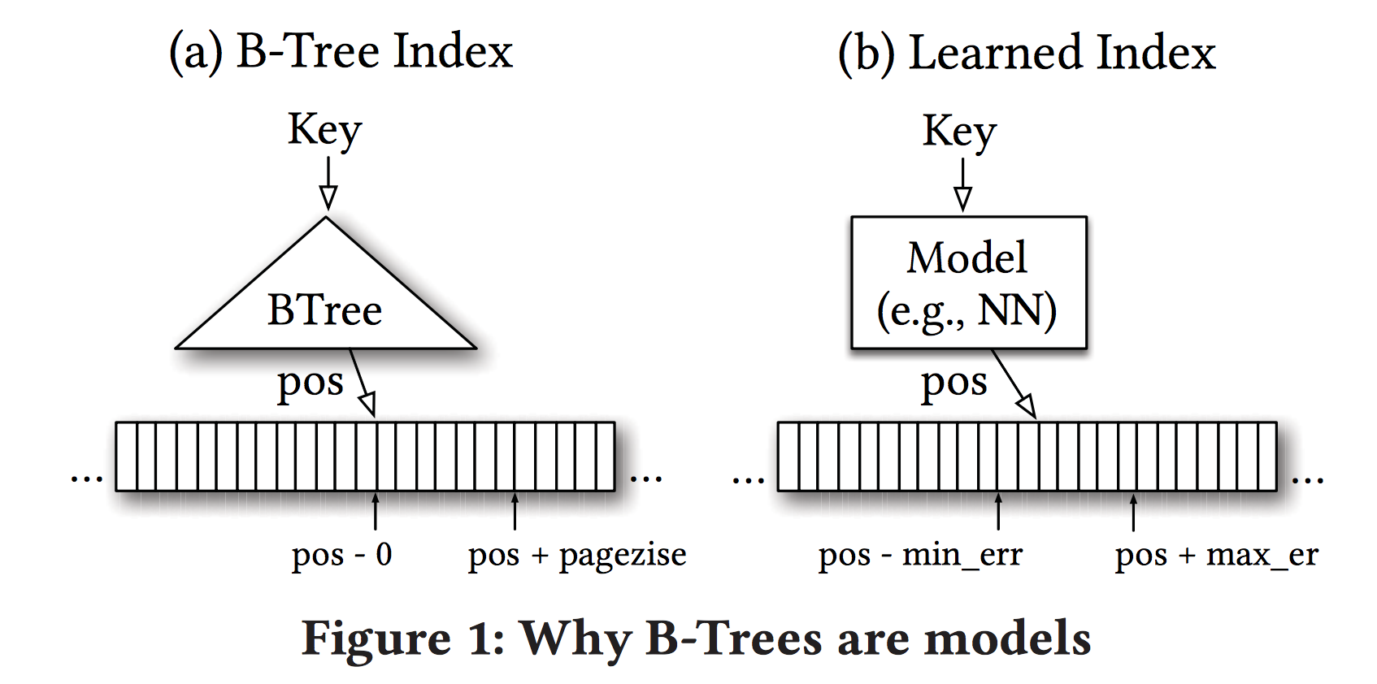
Adaptive Data Management
Section 1 > Lectures

Slide 27
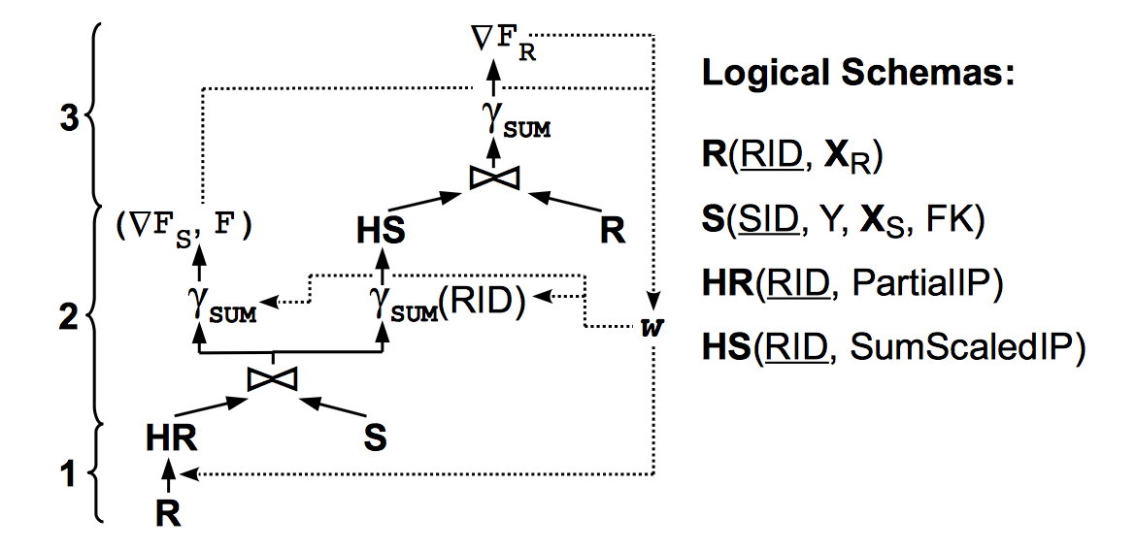
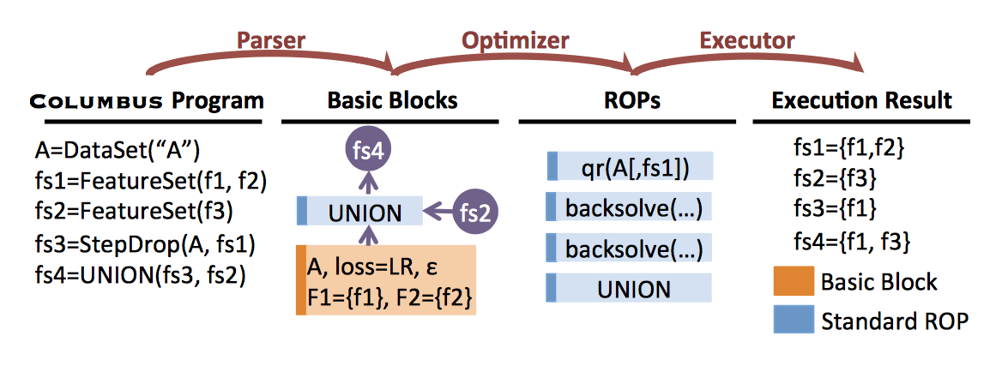
Serving Feature Selection Workloads
Section 1 > Lectures

Slide 28
AutoML
Section 1 > Lectures

Slide 29
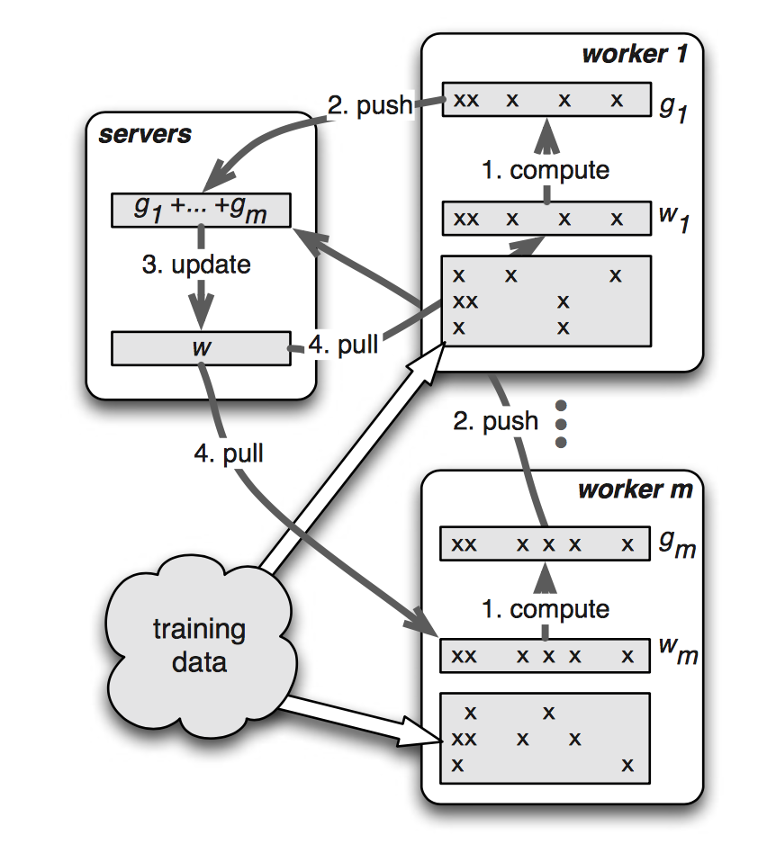
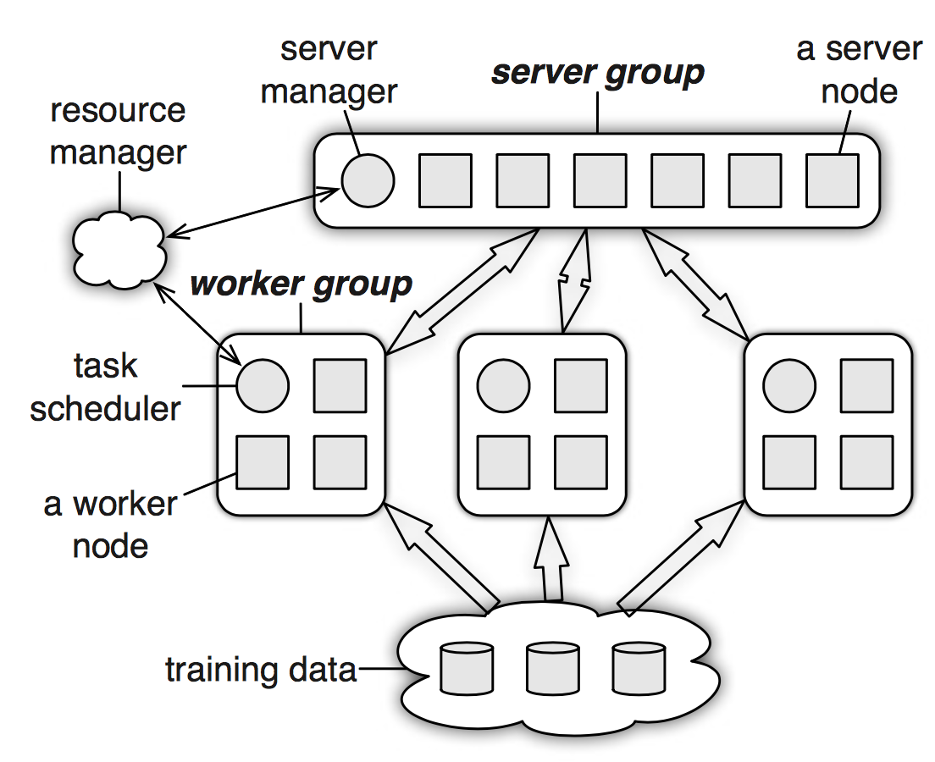
Distributed Model Training
Section 1 > Lectures

Slide 30
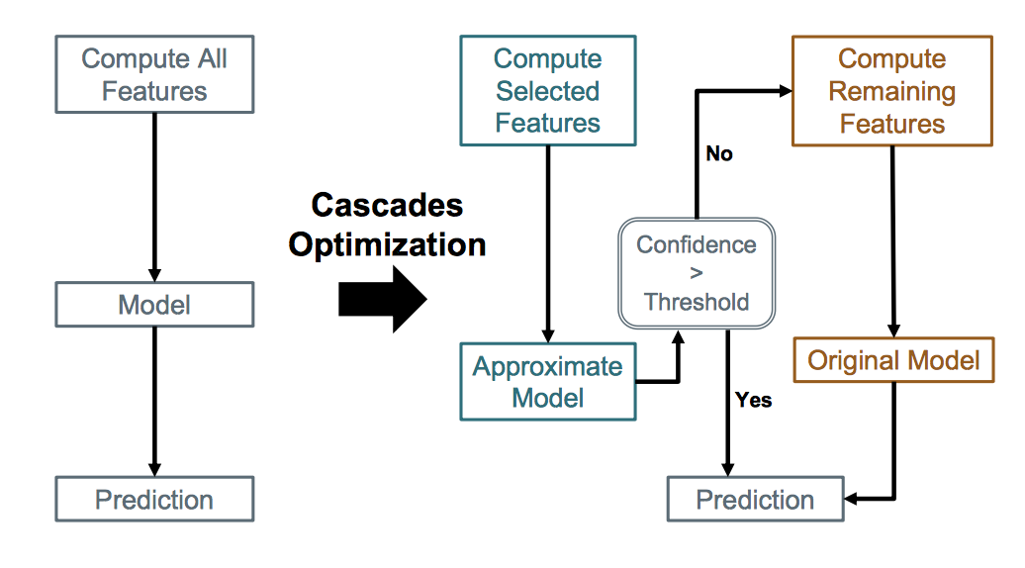
Efficient Prediction Serving
Section 1 > Lectures

Slide 31
Model Compression
Section 1 > Lectures

Slide 32
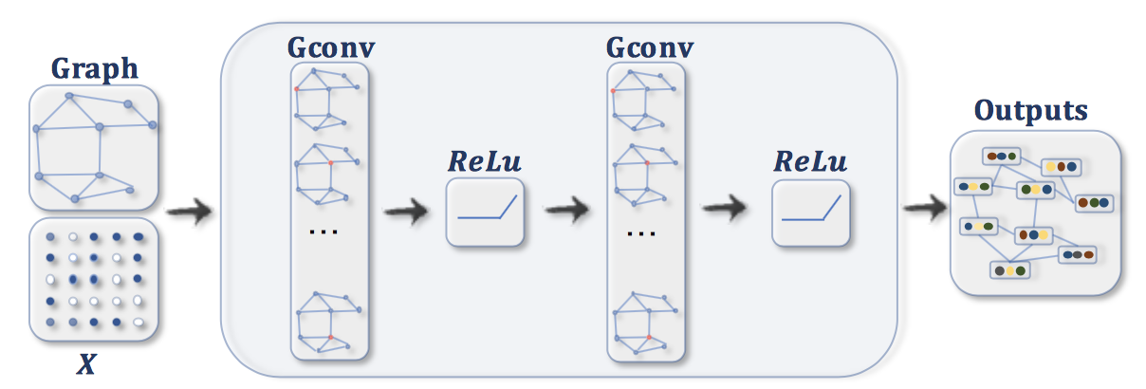
Relational Inductive Bias in Neural Networks
Section 1 > Lectures

