Slide 1
Lecture 10: Buffer Manager and File Organization
Lecture 10

Slide 2
Today’s Lecture
Lecture 10
Recap: Buffer Manager
Replacement Policies
Files and Records

Slide 3
Buffer Manager
Lecture 10 > Section 1

Slide 4
What you will learn about in this section
Lecture 10 > Section 1
Buffer Pool
Buffer Manager

Slide 5
The Buffer (Pool)
Lecture 10 > Section 1
Main Memory
A buffer is a region of physical memory used to store temporary data
In this lecture: a region in main memory used to store intermediate data between disk and processes
Key idea: Reading / writing to disk is slow- need to cache data!
Buffer (Pool)
Disk

Slide 6
Buffer Management in a DBMS
Lecture 10 > Section 1
Data must be in RAM for DBMS to operate on it!
Can’t keep all the DBMS pages in main memory
Buffer Manager: Efficiently uses main memory
Memory divided into buffer frames: slots for holding disk pages
Page Requests from Higher Levels
BUFFER POOL
Upper levels:
release pages when done
indicate if a page is modified
disk page
free frame
MAIN MEMORY
DISK
choice of frame dictated
by the replacement policy
DB
Notes:
4

Slide 7
Buffer Manager
Lecture 10 > Section 1
2 requestors want to modify the same page?
Handled by the concurrency control manager (using locks)
Bookkeeping per frame:
Pin count : # users of the page in the frame
Pinning : Indicate that the page is in use
Unpinning : Release the page, and also indicate if the page is dirtied
Dirty bit : Indicates if changes must be propagated to disk
Notes:
4

Slide 8
Buffer Manager
Lecture 10 > Section 1
When a Page is requested:
In buffer pool -> return a handle to the frame. Done!
Increment the pin count
Not in the buffer pool:
Choose a frame for replacement
(Only replace pages with pin count == 0)
If frame is dirty, write it to disk
Read requested page into chosen frame
Pin the page and return its address
Can you tell the # current users of a page in the BP?
Pin Count!
Notes:
4

Slide 9
Replacement Policies
Lecture 10 > Section 2

Slide 10
What you will learn about in this section
Lecture 10 > Section 2
Replacement Policy
LRU and Clock
Sequential Flooding

Slide 11
Buffer replacement policy
Lecture 10 > Section 2
How do we choose a frame for replacement?
LRU (Least Recently Used)
Clock
MRU (Most Recently Used)
FIFO, random, …
The replacement policy has big impact on # of I/O’s (depends on the access pattern)

Slide 12
LRU
Lecture 10 > Section 2
uses a queue of pointers to frames that have pin count = 0
a page request uses frames only from the head of the queue
when a the pin count of a frame goes to 0, it is added to the end of the queue

Slide 13
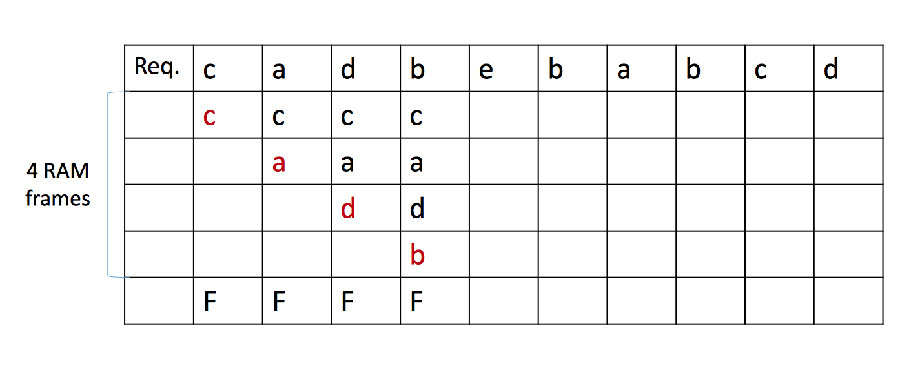
LRU Example
Lecture 10 > Section 2
Buffer pool with 4 frames

Slide 14
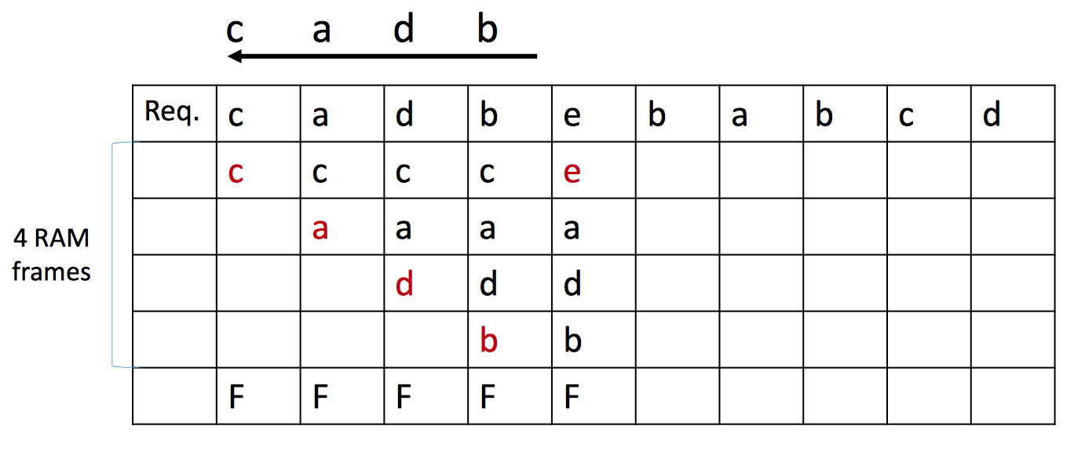
LRU Example
Lecture 10 > Section 3

Slide 15
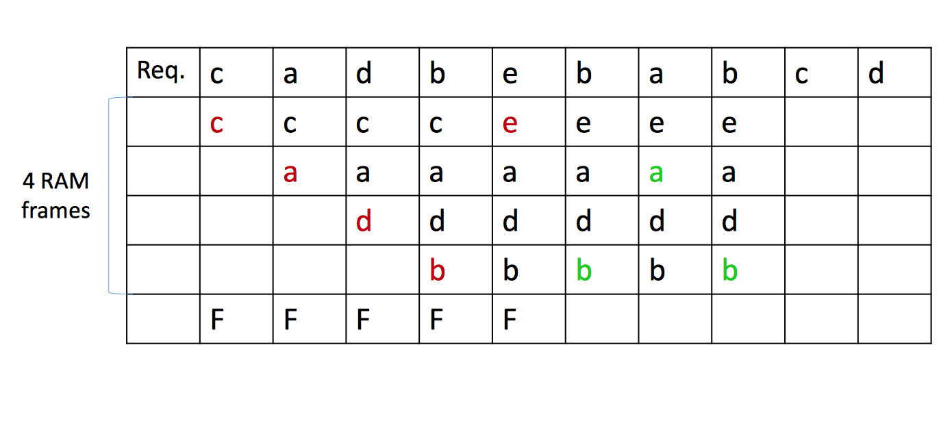
LRU Example
Lecture 10 > Section 2

Slide 16
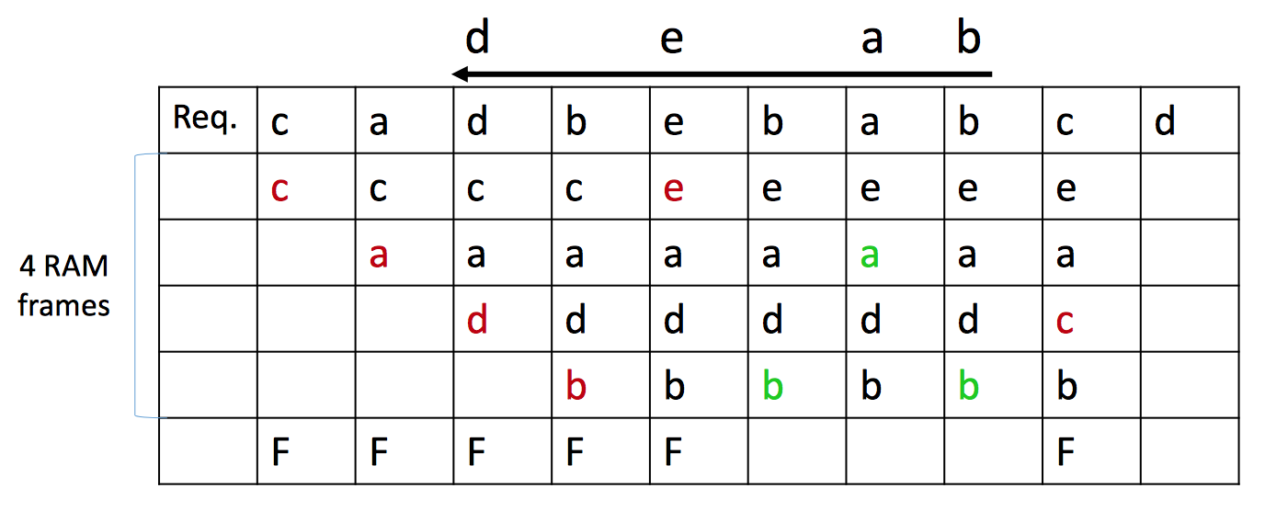
LRU Example
Lecture 10 > Section 2

Slide 17
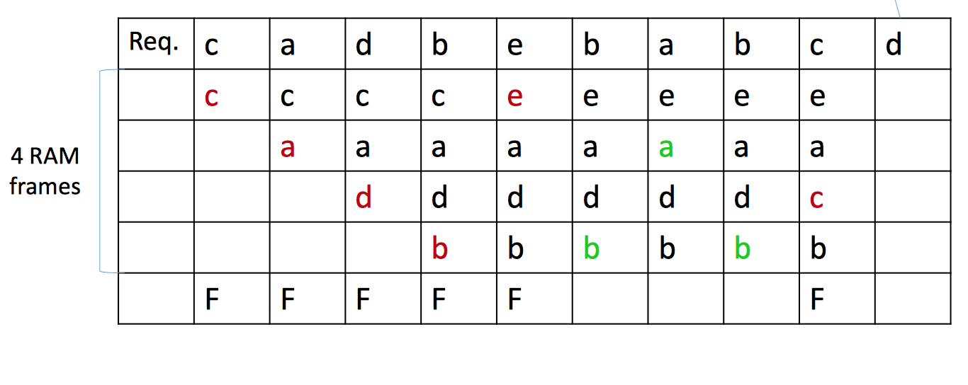
LRU Example
Lecture 10 > Section 2
Which page is
evicted next?

Slide 18
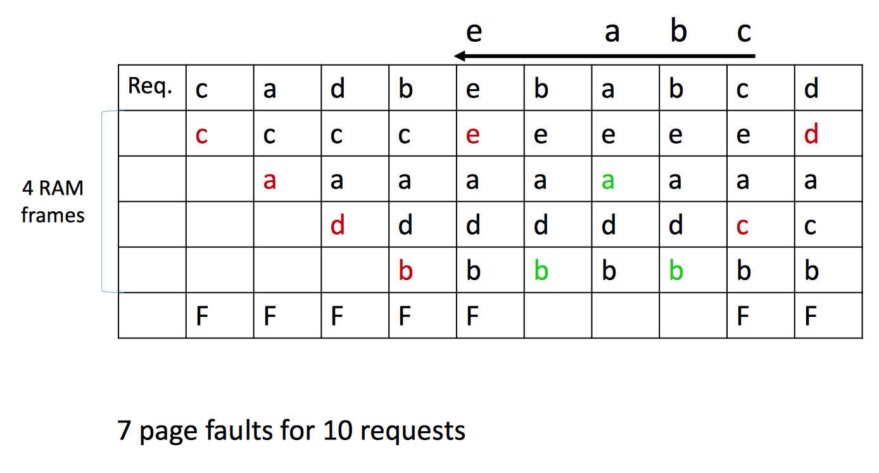
LRU Example
Lecture 10 > Section 2

Slide 19
Clock
Lecture 10 > Section 2
Variant of LRU with lower memory overhead
The N frames are organized into a cycle
Each frame has a referenced bit that is set to 1 when pin count becomes 0
A current variable points to a frame
When a frame is considered:
If pin count > 0, increment current
If referenced = 1, set to 0 and increment
If referenced = 0 and pin count = 0, choose the page

Slide 20
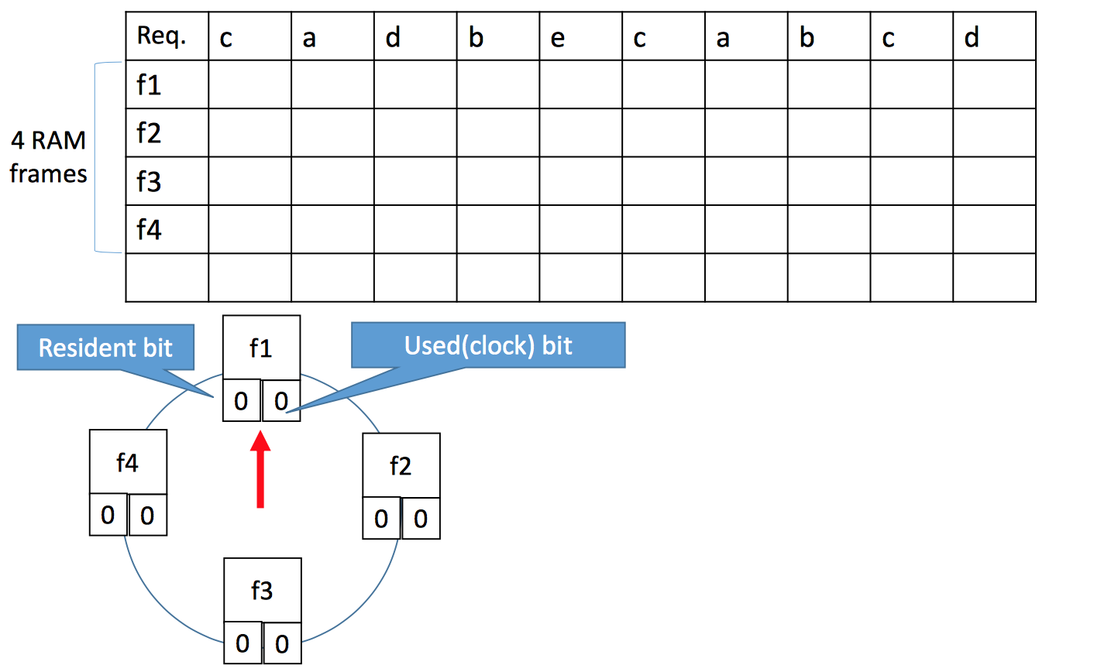
Clock Example
Lecture 10 > Section 2
Referenced bit

Slide 21
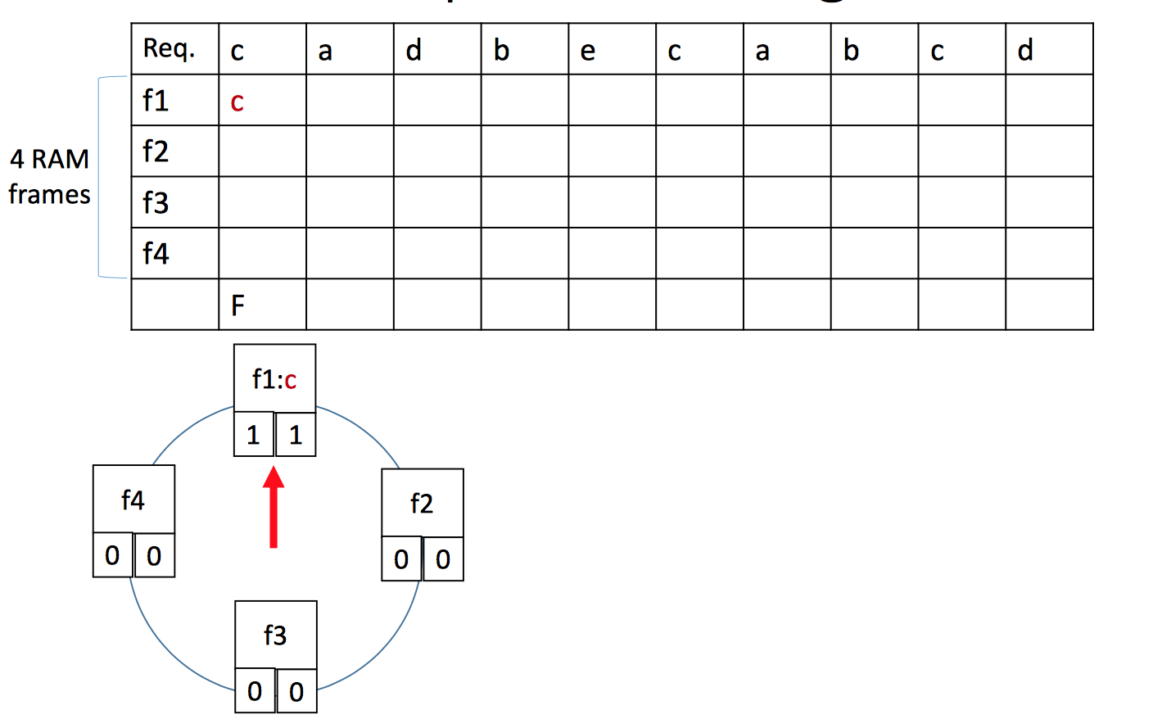
Clock Example
Lecture 10 > Section 2

Slide 22
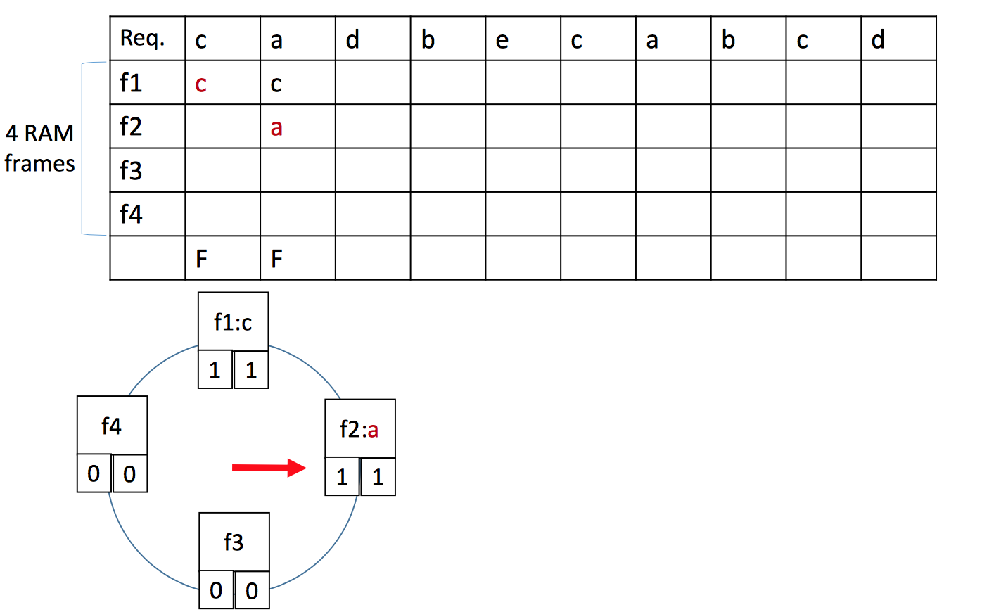
Clock Example
Lecture 10 > Section 2

Slide 23
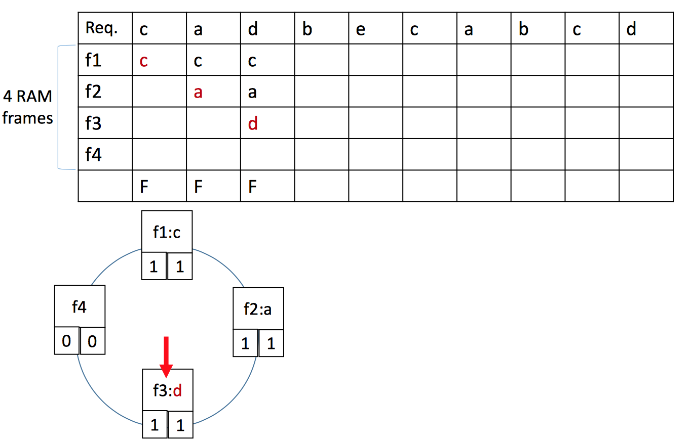
Clock Example
Lecture 10 > Section 2

Slide 24
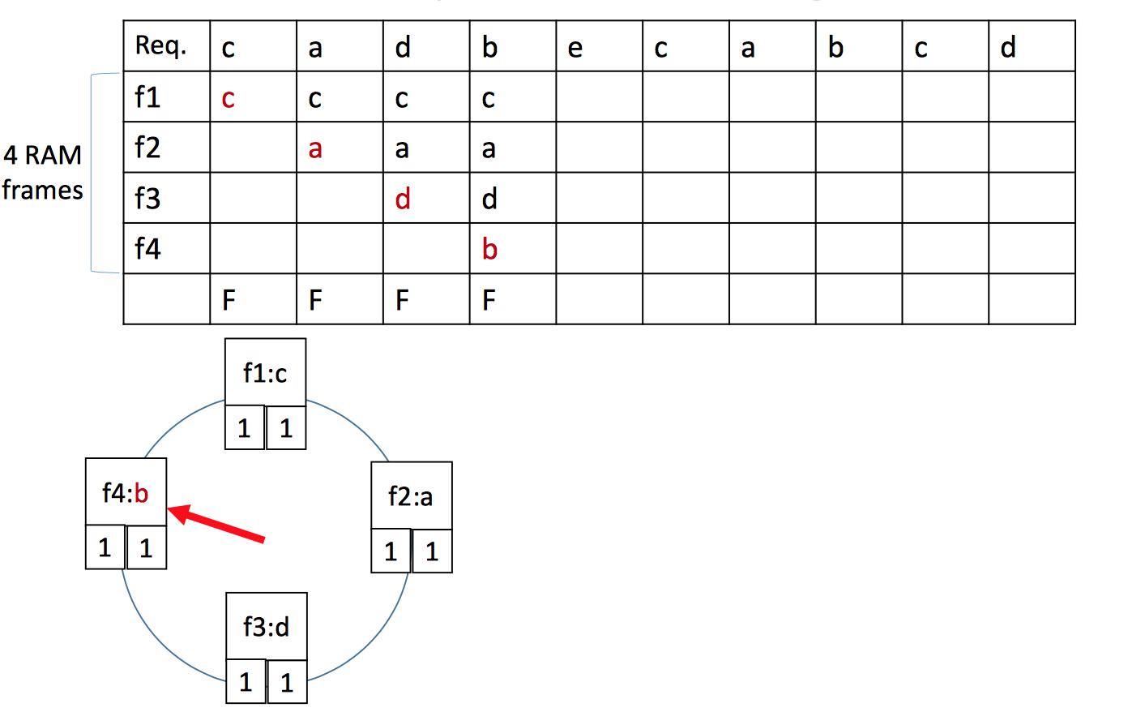
Clock Example
Lecture 10 > Section 2

Slide 25
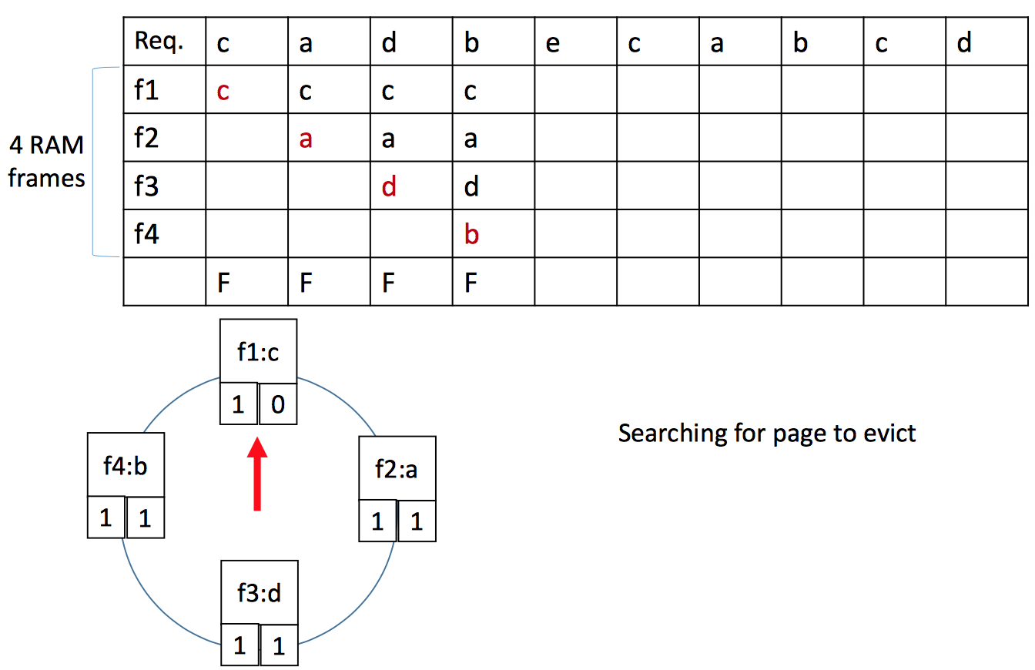
Clock Example
Lecture 10 > Section 2

Slide 26
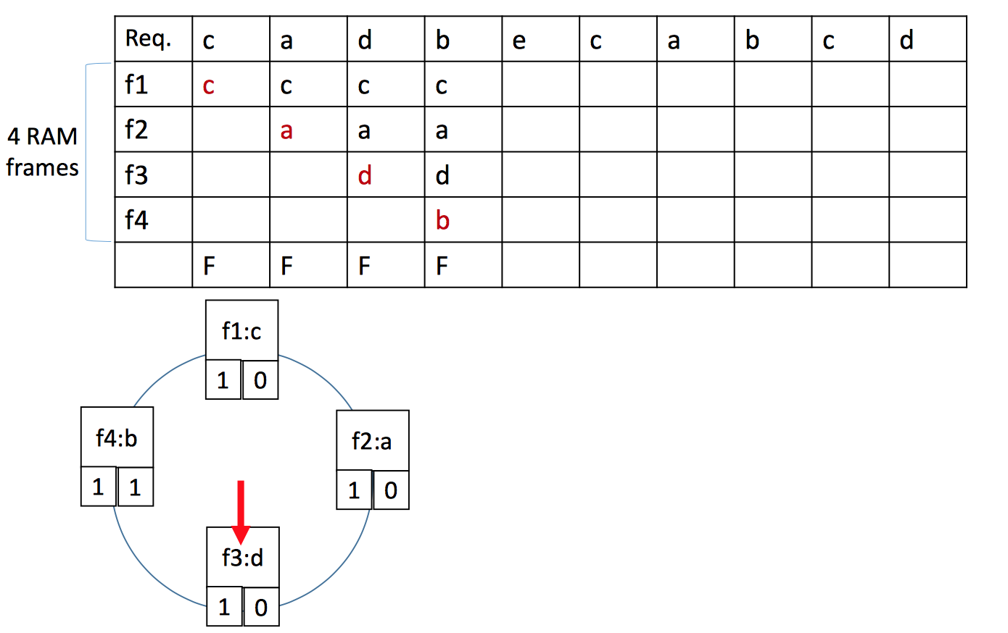
Clock Example
Lecture 10 > Section 2

Slide 27
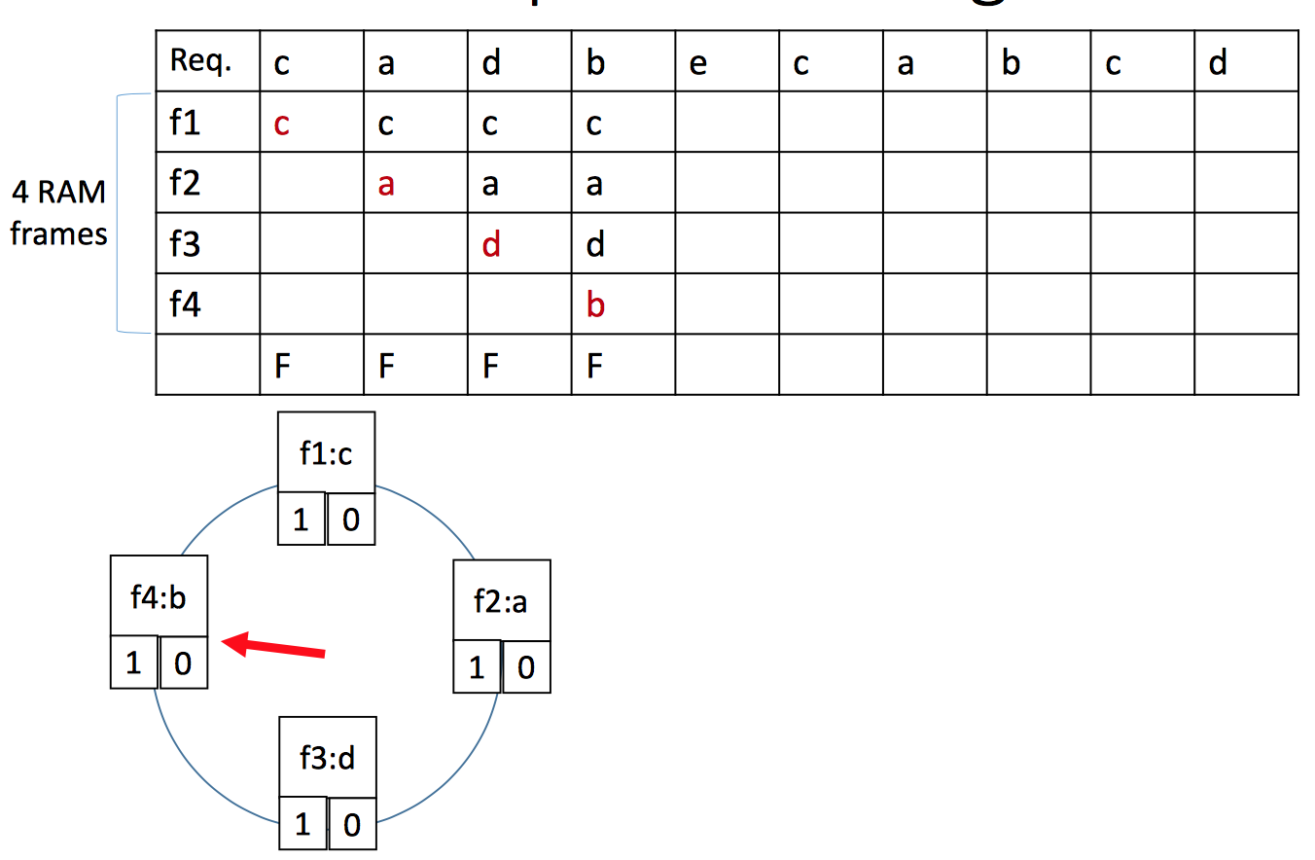
Clock Example
Lecture 10 > Section 2

Slide 28
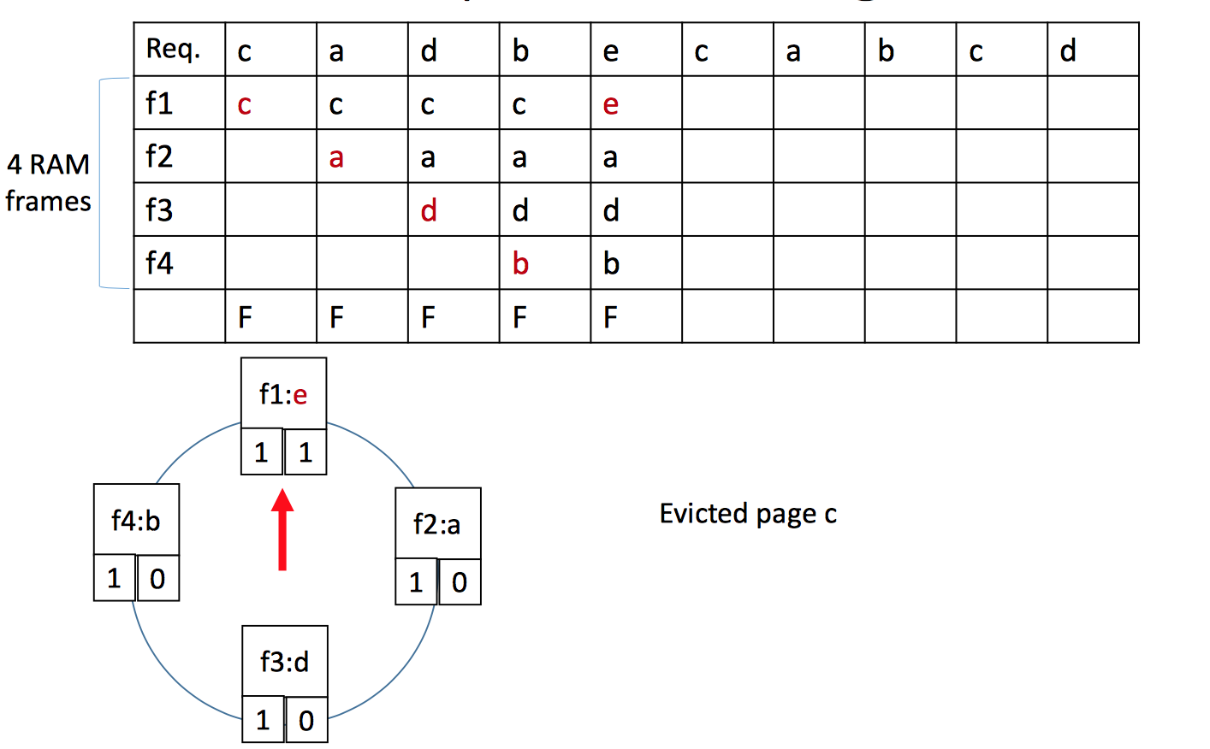
Clock Example
Lecture 10 > Section 2

Slide 29
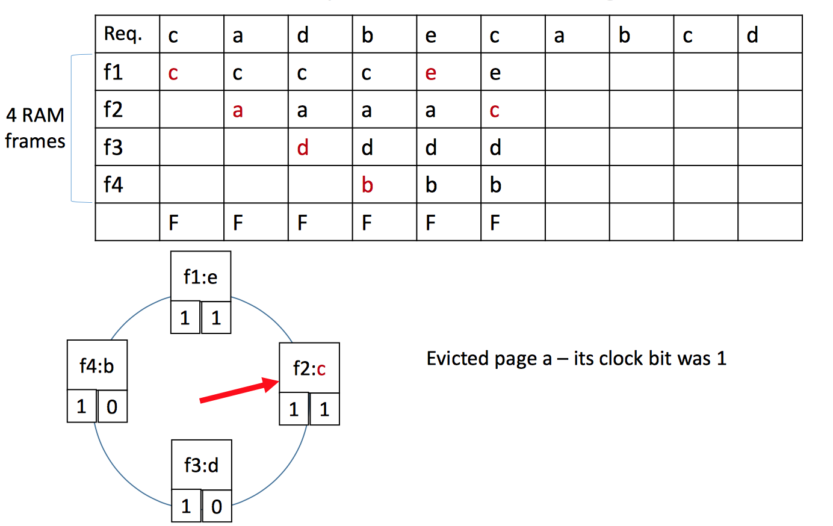
Clock Example
Lecture 10 > Section 2

Slide 30
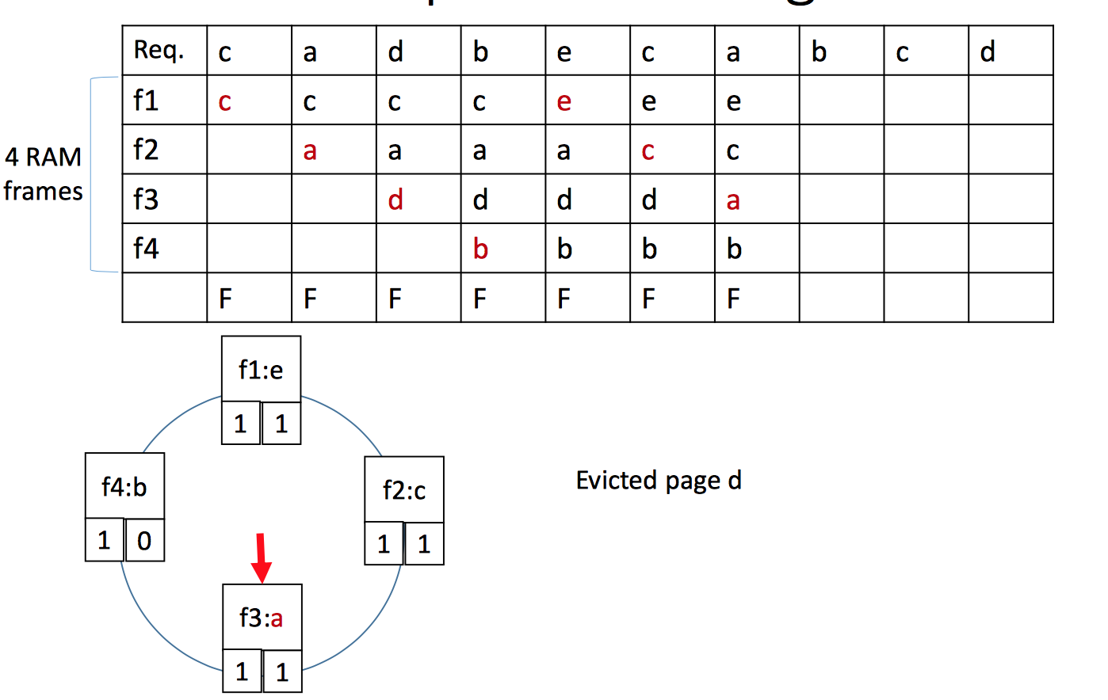
Clock Example
Lecture 10 > Section 2

Slide 31
Clock Example
Lecture 10 > Section 2

Slide 32
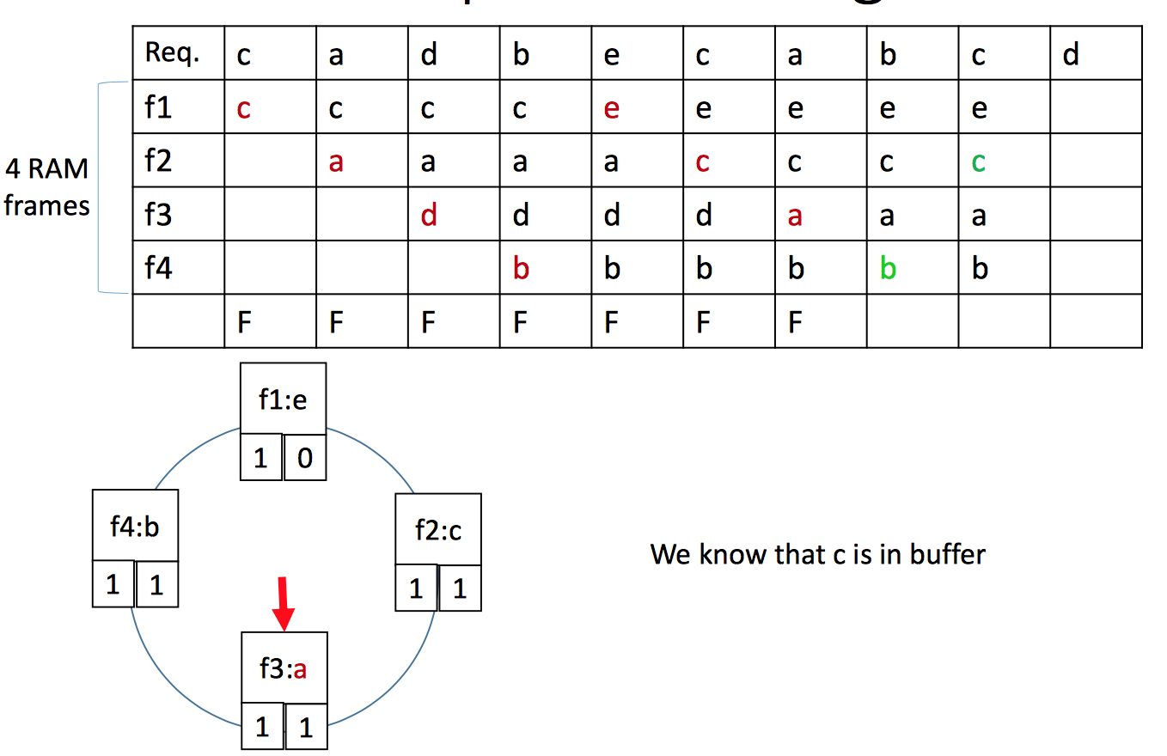
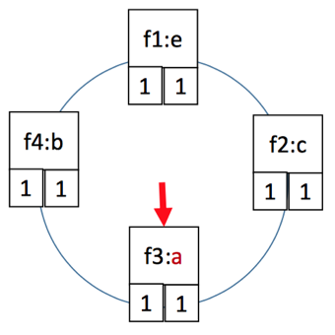
Clock Example
Lecture 10 > Section 2

Slide 33
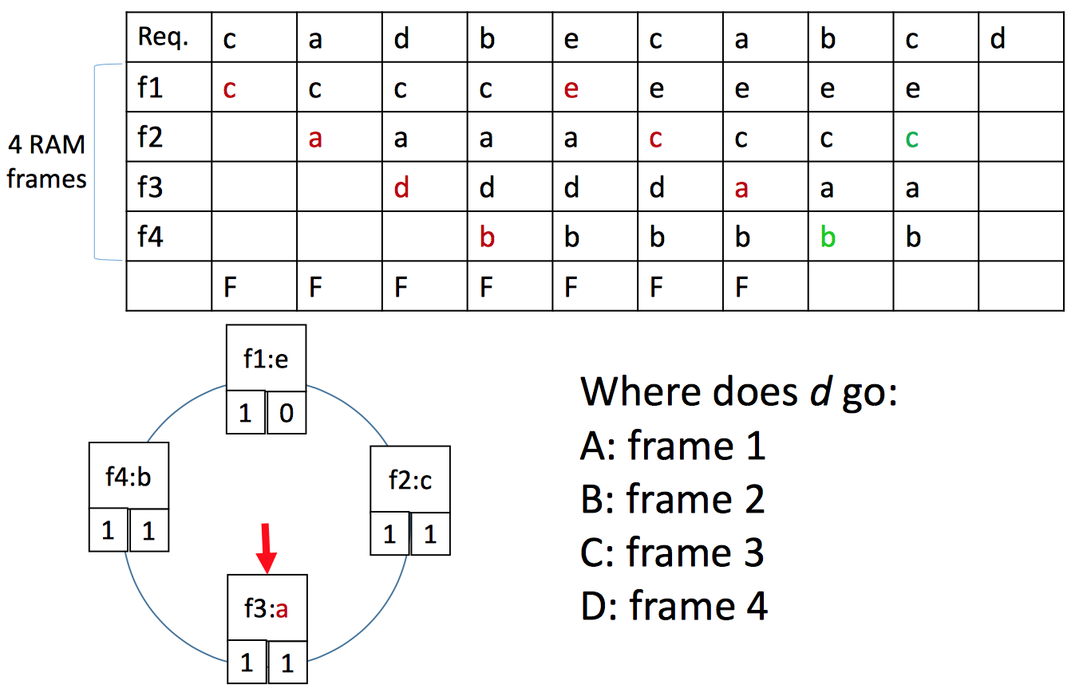
Clock Example
Lecture 10 > Section 2

Slide 34
Sequential Flooding
Lecture 10 > Section 2
Nasty situation caused by LRU policy + repeated sequential scans
# buffer frames < # pages in file
each page request causes an I/O !!
MRU much better in this situation

Slide 35
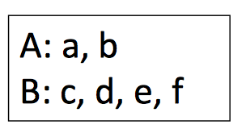
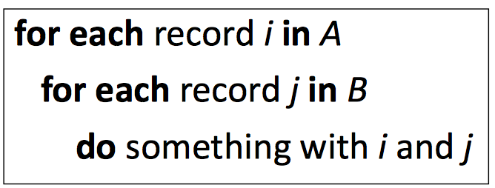
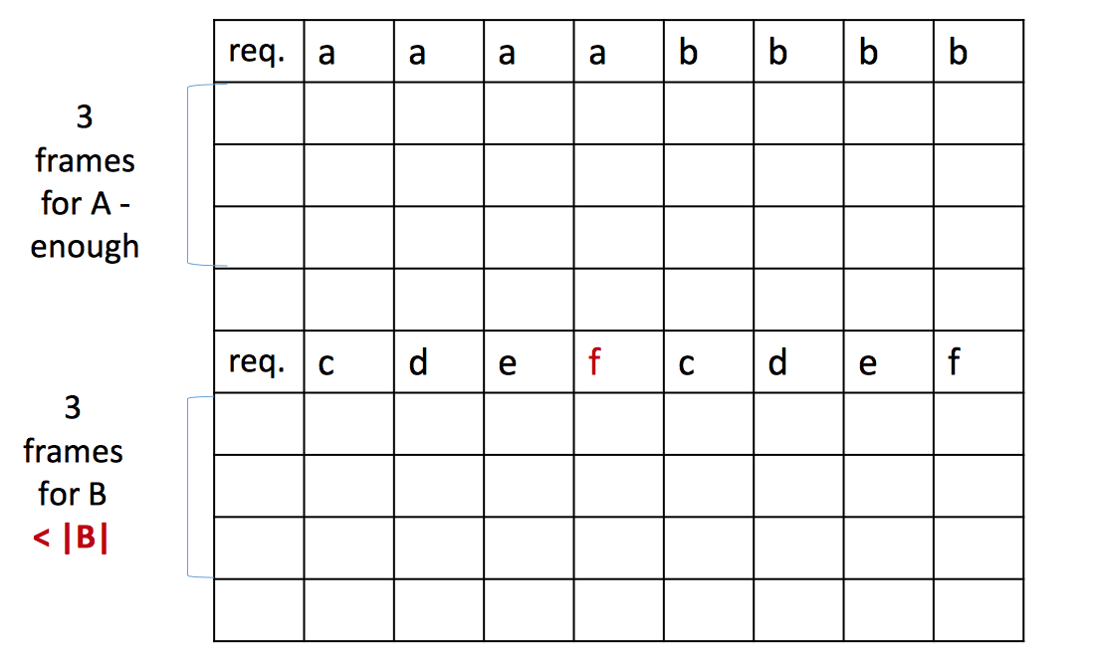
Sequential Flooding Example
Lecture 10 > Section 2
Nested Loop

Slide 36
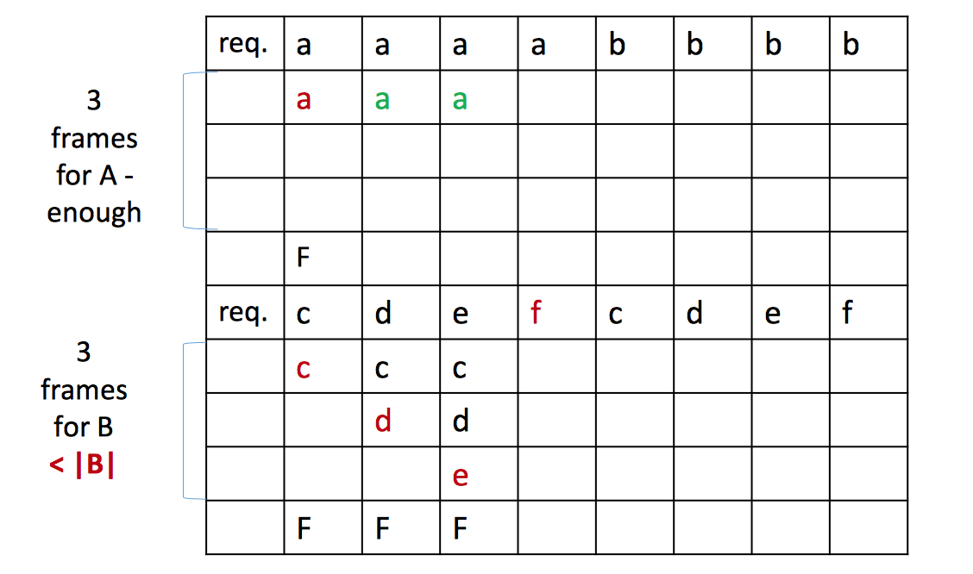
Sequential Flooding Example
Lecture 10 > Section 2
Nested Loop

Slide 37
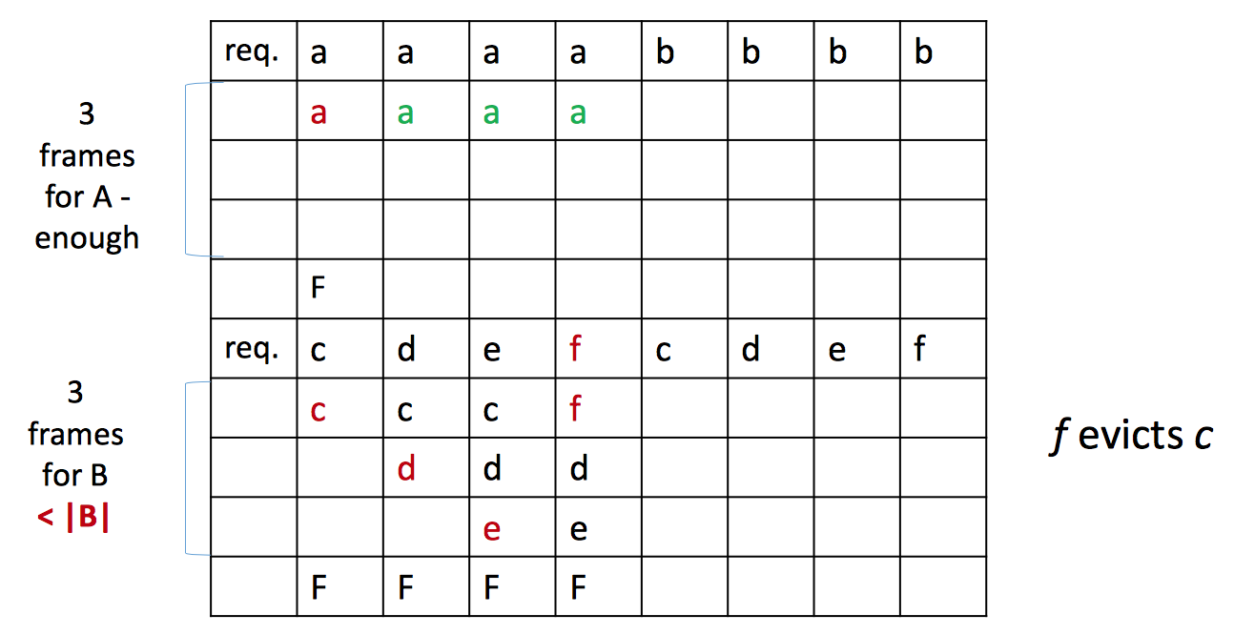
Sequential Flooding Example
Lecture 10 > Section 2
Nested Loop

Slide 38
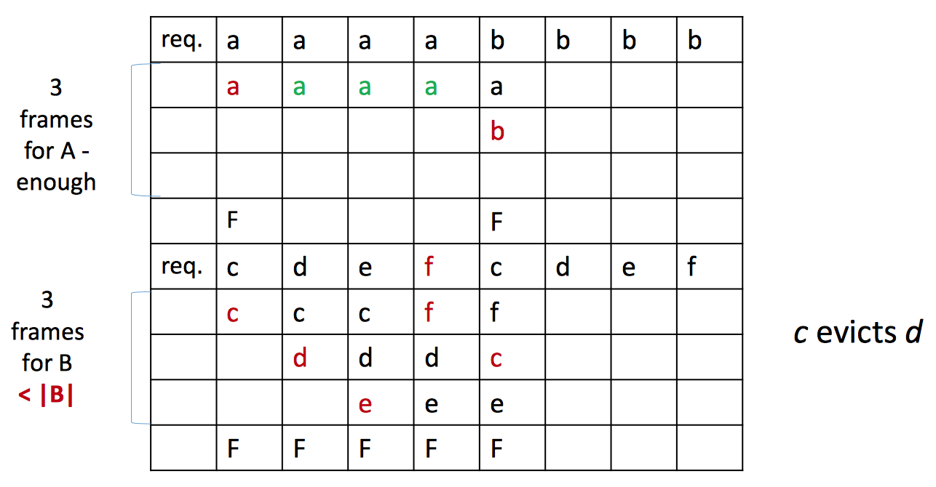
Sequential Flooding Example
Lecture 10 > Section 2
Nested Loop

Slide 39
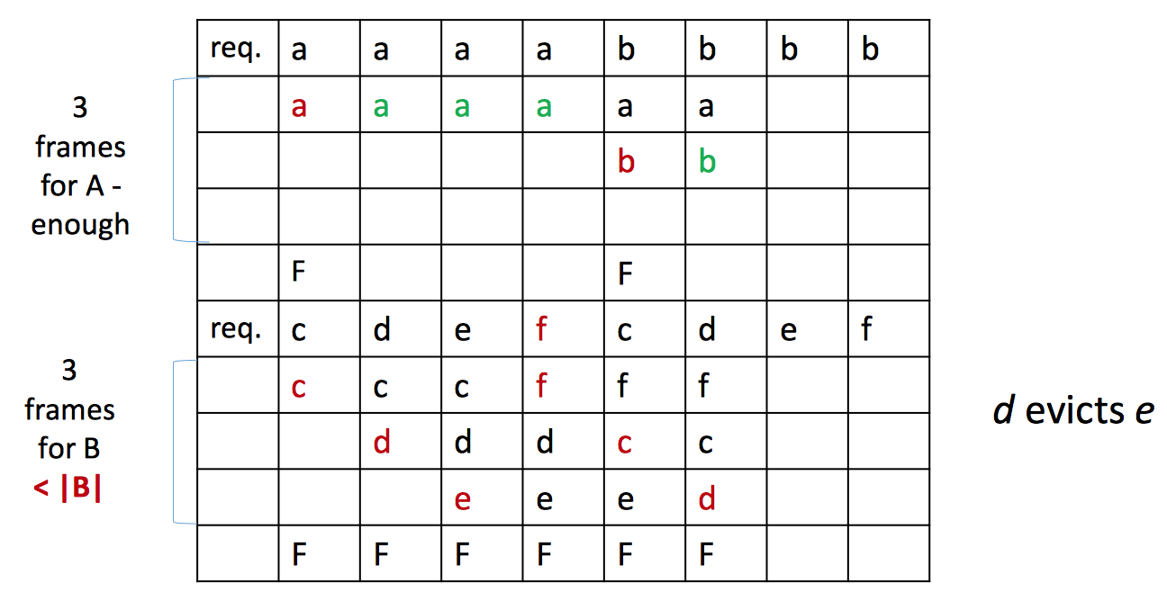
Sequential Flooding Example
Lecture 10 > Section 2
Nested Loop

Slide 40
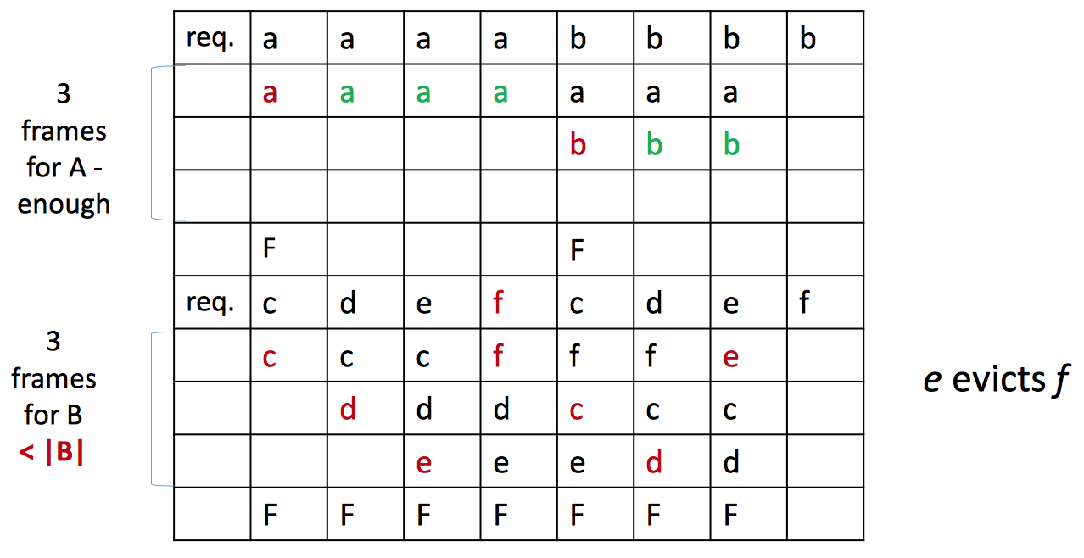
Sequential Flooding Example
Lecture 10 > Section 2
Nested Loop

Slide 41
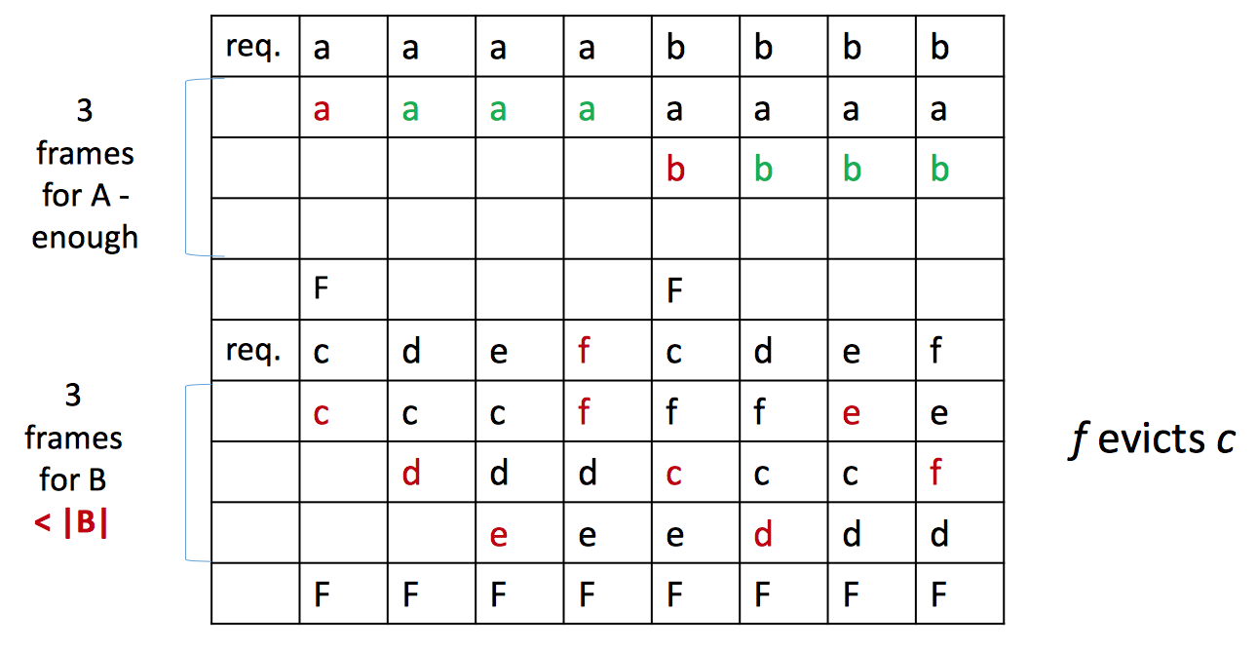
Sequential Flooding Example
Lecture 10 > Section 2
Nested Loop

Slide 42
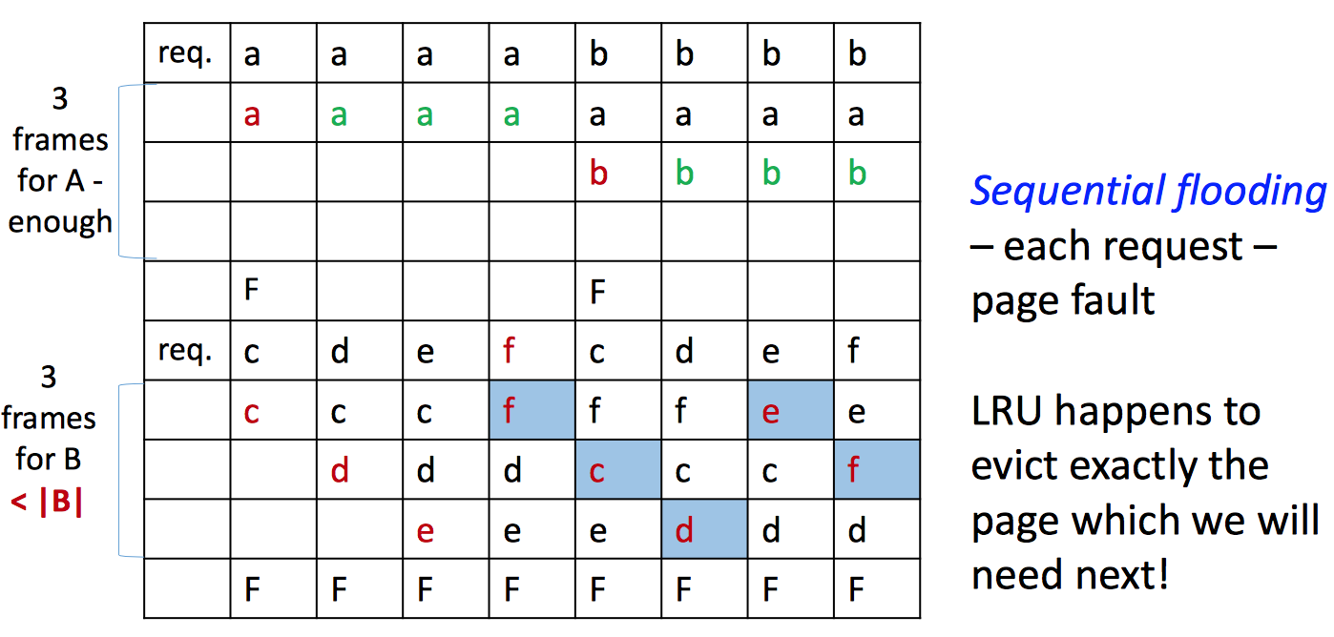
Sequential Flooding Example
Lecture 10 > Section 2
Nested Loop
LRU happens to evict exactly the page which we will need next!!!

Slide 43
Sequential Flooding
Lecture 10 > Section 2
Nasty situation caused by LRU policy + repeated sequential scans
# buffer frames < # pages in file
each page request causes an I/O !!
MRU much better in this situation

Slide 44
Files and Records
Lecture 10 > Section 3

Slide 45
What you will learn about in this section
Lecture 10 > Section 3
File Organization
Page Organization
BONUS: Column Stores

Slide 46
Managing Disk Space
Lecture 10 > Section 3
The disk space is organized into files
Files are made up of pages
Pages contain records
Page or block is OK for I/O, but higher levels operate on records, and files of records.

Slide 47
File Operations
Lecture 10 > Section 3
The disk space is organized into files
Files are made up of pages
Pages contain records
File operations:
insert/delete/modify record
read a particular record (specified using the record id)
scan all records (possibly with some conditions on the records to be retrieved)

Slide 48
File Organization: Unordered (Heap) Files
Lecture 10 > Section 3
Simplest file structure contains records in no particular order.
As file grows and shrinks, disk pages are allocated and de-allocated.
To support record level operations, we must:
keep track of the pages in a file: page id (pid)
keep track of free space on pages
keep track of the records on a page: record id (rid)
Many alternatives for keeping track of this information
Operations: create/destroy file, insert/delete record, fetch a record with a specified rid, scan all records

Slide 49
Heap File as a List
Lecture 10 > Section 3
Data
Page
Data
Page
Data
Page
Full pages
Header
Page
Data
Page
Data
Page
Data
Page
Pages with free space
(heap file name, header page id) recorded in a known location
Each page contains two pointers plus data: Pointer = Page ID (pid)
Pages in the free space list have “some” free space
Q: What happens with variable length records?
A: All pages are going to have free space, but maybe we will have to go through a lot of them before we find one with enough space.
Notes:
If a new page is required for inserting a tuple, ask the disk space manager to allocate the page. Add it to the list of pages (free space list), and insert a tuple
If we have variable records, then all pages are going to have free space, but maybe we will have to go through a lot of them before we find one with enough space

Slide 50
Heap File as a Page Directory
Lecture 10 > Section 3
Header page
Data
Page 1
Each entry for a page keeps track of:
is the page free or full?
how many free bytes are?
We can now locate pages for new tuples faster!
Data
Page 2
…
Data
Page N
DIRECTORY
Notes:
If a new page is required for inserting a tuple, ask the disk space manager to allocate the page. Add it to the list of pages (free space list), and insert a tuple
If we have variable records, then all pages are going to have free space, but maybe we will have to go through a lot of them before we find one with enough space

Slide 51
Managing Disk Space
Lecture 10 > Section 3
Files made up of pages
and pages contain records
But file operations are on records:
File operations:
insert/delete/modify record
read a particular record (specified using the record id)
scan all records (possibly with some conditions on the records to be retrieved)
Notes:
If a new page is required for inserting a tuple, ask the disk space manager to allocate the page. Add it to the list of pages (free space list), and insert a tuple
If we have variable records, then all pages are going to have free space, but maybe we will have to go through a lot of them before we find one with enough space

Slide 52
Page Organization: Page Formats
Lecture 10 > Section 3
A page is collection of records
Slotted page format
A page is a collection of slots
Each slot contains a record
rid = <page id, slot number>
There are many slotted page organizations
We need to have support for:
search, insert, delete records on a page
Notes:
If a new page is required for inserting a tuple, ask the disk space manager to allocate the page. Add it to the list of pages (free space list), and insert a tuple
If we have variable records, then all pages are going to have free space, but maybe we will have to go through a lot of them before we find one with enough space

Slide 53
Page Formats: Fixed Length Records
Lecture 10 > Section 3
Record id = <page id, slot #>
Slot 1
Slot 2
. . .
Free
Space
Packed organization: N records are always stored in the first N slots.
Slot N
N
number
of records
PACKED
Moving records changes rid! May not be acceptable.
Notes:
11

Slide 54
Page Formats: Fixed Length Records
Lecture 10 > Section 3
Record id = <page id, slot #>
Slot 1
Slot 2
Free
Space
. . .
Unpacked Organization: use a bitmap to locate records in the page.
Slot N
Slot M
1
. . .
1
1
0
M
M ... 3 2 1
number
of slots
UNPACKED, BITMAP
Notes:
11

Slide 55
Page Formats: Variable Length Records
Lecture 10 > Section 3
Page num = 11
Rid=?
Rid= (11, 1)
120,
40
-1,
0
560,
90
-1,
0
0,
70
70,
50
6
Book-keeping
5
4
3
2
1
0
Directory grows backwards!
Move records on same page; rid unchanged! Good for fixed-length records too.
Free Space
Pointer
Slot directory
Delete a record?
Slot Entry: Offset,
record
length
Number of slots
Notes:
11

Slide 56
Page Formats: Variable Length Records
Lecture 10 > Section 3
Deletion:
offset is set to -1
Insertion:
use any available slot
if no space is available, reorganize
rid remains unchanged when we move the record (since it is defined by the slot number)
Notes:
11

Slide 57
Page Formats: Variable Length Records
Lecture 10 > Section 3
Page num = 11
Rid=?
Rid= (11, 1)
120,
40
-1,
0
560,
90
-1,
0
0,
70
70,
50
6
Book-keeping
5
4
3
2
1
0
Directory grows backwards!
Move records on same page; rid unchanged! Good for fixed-length records too.
Free Space
Pointer
Slot directory
Delete a record
Offset is set to -1
Slot Entry: Offset,
record
length
Number of slots
Notes:
11

Slide 58
Lecture 10 > Section 3
Record Formats: Fixed Length
F1
F2
F3
F4
L1
L2
L3
L4
Base address (B)
Address = B+L1+L2
All records on the page are the same length
Information about field types same for all records in a file; stored in system catalogs.
Notes:
9
Seen how pages are fetched from disk to main memory, now look at how pages are organized on disks.

Slide 59
Lecture 10 > Section 3
Record Formats: Variable Length
Two alternative formats (# fields is fixed):
F1 F2 F3 F4
4
$
$
$
$
Field
Count
Field delimiter (special symbol)
Array of Offsets
Use an array of integer offsets in the beginning
Second alternative offers direct access to i’th field
Efficient storage of nulls
Small directory overhead.
Issues with growing records!
changes in attribute value, add/drop attributes
Records larger than pages
Notes:
10

Slide 60
Column Stores: Motivation
Lecture 10 > Section 3
Consider a table:
Foo (a INTEGER, b INTEGER, c VARCHAR(255), …)
And the query`:
SELECT a FROM Foo WHERE a > 10
What happens with the previous record format in terms of the bytes that have to be read from the IO subsystem?

Slide 61
Column Stores: Motivation
Lecture 10 > Section 3
Store data “vertically”
Contrast that with a “row-store” that stores all the attributes of a tuple/record contiguously
The previous record formats are “row stores”
111
212
It was a cold morning
111
212
It was a cold morning
222
222
Warm and sunny here
222
222
Warm and sunny here
333
232
Artic winter conditions
333
232
Artic winter conditions
444
242
Tropical weather
444
242
Tropical weather
File 1
File 2
File 3
Each file is a set of pages.
Columns can be stored in compressed form

Slide 62
Column Stores: Motivation
Lecture 10 > Section 3
Are there any disadvantages associated with column stores?
Updates are slower
Retrieving back more than one attribute can be slower, e.g. Queries like SELECT * are slower
Notes:
Disadvantages: updates are generally slower, queries like SELECT * are slower.

