Slide 1
Lecture 8: Snorkel + Data Programming
Slides by Alex Ratner

Slide 2
Logistics
Projects Discussion
Project Proposals (Due next Tuesday 2/27)
One-page description of what you want to work on
Elements:
What is the Problem?
Why is it interesting and important?
Why is it hard?
Why hasn’t it been solved before?
If you have a plan of attack please list
Individual meetings to discuss your proposals

Slide 3
Lecture 8: Snorkel + Data Programming
Slides by Alex Ratner

Slide 4
MOTIVATION:
In practice, training data is often:
The bottleneck
The practical injection point for domain knowledge

Slide 5
KEY IDEA:
We can use higher-level, weaker supervision to program ML models

Slide 6
Outline
The Labeling Bottleneck: The new pain point of ML
Data Programming + Snorkel: A framework for weaker, more efficient supervision
In practice: Empirical results & user studies

Slide 7
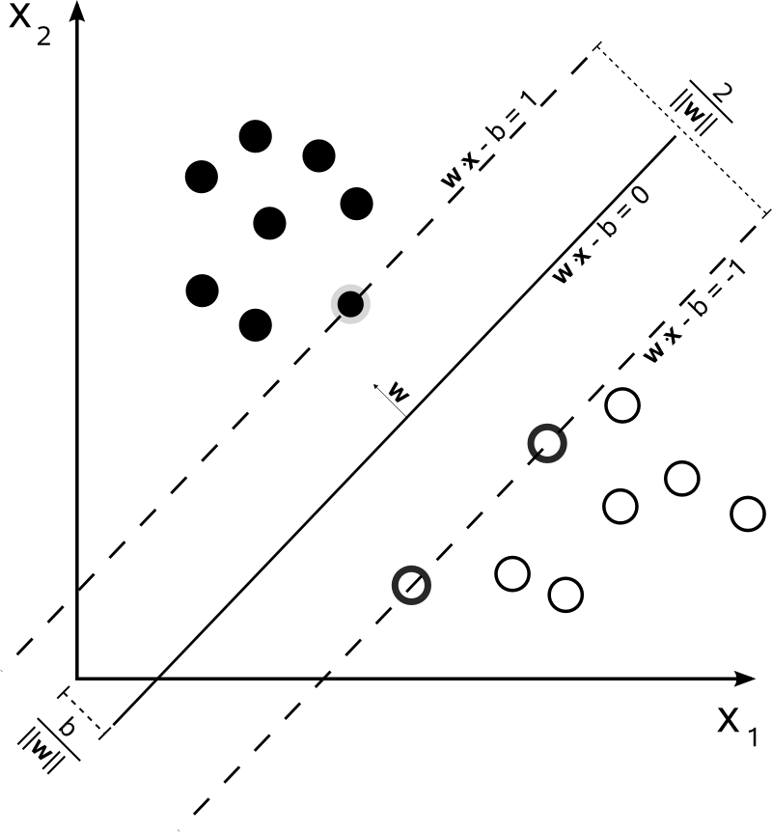
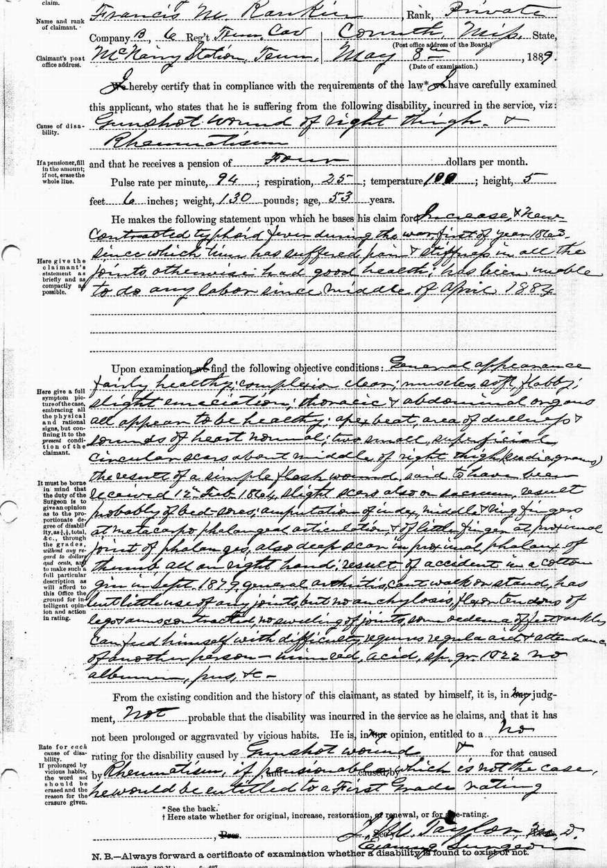
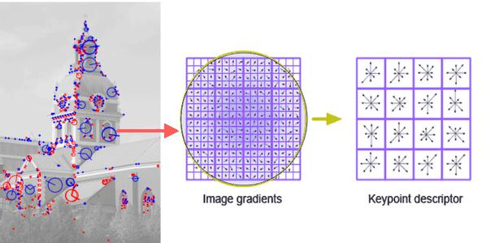
The ML Pipeline Pre-Deep Learning
Collection
Labeling
Feature Engineering
Training
True
False
Feature engineering used to be the bottleneck…

Slide 8
The ML Pipeline Today
Collection
Labeling
Training
Representation Learning
True
False
New pain point, new injection point

Slide 9
Training Data: Challenges & Opportunities
Expensive & Slow:
Especially when domain expertise needed
Static:
Real-world problems change; hand-labeled training data does not.
An opportunity to inject domain knowledge:
Modern ML models are often too complex for hand-tuned structures, priors, etc.
How do we get—and use—training data more effectively?

Slide 10
Data Programming + Snorkel
A Framework + System for Creating Training Data with Weak Supervision
NIPS 2016
SIGMOD (Demo) 2017

Slide 11
KEY IDEA:
Get users to provide higher-level (but noisier) supervision,
Then model & de-noise it (using unlabeled data) to train high-quality models

Slide 12
Data Programming Pipeline in Snorkel
Input: Labeling Functions,
Unlabeled data
Generative Model
Noise-Aware Discriminative Model
Ex. Application: Knowledge Base Creation (KBC)
DOMAIN EXPERT
def lf1(x):
cid = (x.chemical_id, x.disease_id)
return 1 if cid in KB else 0
$$λ_{1}$$
h_{1,1}
x_{1,1}
def lf2(x):
m = re.search(r’.*cause.*’, x.between)
return 1 if m else 0
y₁
h_{1,2}
$$λ_{2}$$
$$Y$$
x_{1,2}
Output: Probabilistic Training Labels
h_{1,3}
def lf3(x):
m = re.search(r’.*not cause.*’, x.between)
return 1 if m else 0
$$λ_{3}$$
1
2
3
Users write labeling functions to generate noisy labels
We model the labeling functions’ behavior to de-noise them
We use the resulting prob. labels to train a model
Notes:
Add: “We show in the paper that both of these phases are necessary for high quality”

Slide 13
Surprising Point: No hand-labeled training data!

Slide 14
Step 1: Writing Labeling Functions
DOMAIN EXPERT
def lf1(x):
cid = (x.chemical_id, x.disease_id)
return 1 if cid in KB else 0
$$λ_{1}$$
h_{1,1}
x_{1,1}
def lf2(x):
m = re.search(r’.*cause.*’, x.between)
return 1 if m else 0
$$λ_{2}$$
$$Y$$
y₁
h_{1,2}
x_{1,2}
h_{1,3}
def lf3(x):
m = re.search(r’.*not cause.*’, x.between)
return 1 if m else 0
$$λ_{3}$$
DOMAIN EXPERT
def lf1(x):
cid = (x.chemical_id, x.disease_id)
return 1 if cid in KB else 0
def lf2(x):
m = re.search(r’.*cause.*’, x.between)
return 1 if m else 0
def lf3(x):
m = re.search(r’.*not cause.*’, x.between)
return 1 if m else 0
A Unifying Framework for Expressing Weak Supervision

Slide 15
Example: Chemical-Disease Relation Extraction from Text
We define candidate entity mentions:
Chemicals
Diseases
Goal: Populate a relational schema with relation mentions
ID | Chemical | Disease | Prob.
00 | magnesium | Myasthenia gravis | 0.84
01 | magnesium | quadriplegic | 0.73
02 | magnesium | paralysis | 0.96
KNOWLEDGE BASE (KB)

Slide 16
Labeling Functions
Traditional “distant supervision” rule relying on external KB
def lf1(x):
cid =(x.chemical_id,x.disease_id)
return 1 if cid in KB else 0
”Chemical A is found to cause disease B under certain conditions…”
Label = TRUE
Existing KB
This is likely to be true… but
Contains (A,B)

Slide 17
Labeling Functions
Traditional “distant supervision” rule relying on external KB
def lf1(x):
cid =(x.chemical_id,x.disease_id)
return 1 if cid in KB else 0
”Chemical A was found on the floor near a person with disease B…”
Label = TRUE
Existing KB
…can be false!
Contains (A,B)
We will learn the accuracy of each LF (next)

Slide 18
Writing Labeling Functions in Snorkel
Labeling functions take in Candidate objects:
Three levels of abstraction for writing LFs in Snorkel:
Python code
LF templates
LF generators
Document
Candidate(A,B)
def lf1(x):
cid =(x.chemical_id,x.disease_id)
return 1 if cid in KB else 0
Sentence
Span
Entity
lf1 = LF_DS(KB)
CONTEXT HIERARCHY
Key Point: Supervision as code
for lf in LF_DS_hier(KB, cut_level=2):
yield lf
A knowledge base (KB) with hierarchy

Slide 19
Supported by Simple Jupyter Interface
snorkel.stanford.edu

Slide 20
Broader Perspective: A Template for Weak Supervision

Slide 21
A Unifying Method for Weak Supervision
Distant supervision
Crowdsourcing
Weak classifiers
Domain heuristics / rules
$$λ :X ↦Y∪\{∅\}$$

Slide 22
How to handle such a diversity of weak supervision sources?

Slide 23
Step 2: Modeling Weak Supervision
DOMAIN EXPERT
def lf1(x):
cid = (x.chemical_id, x.disease_id)
return 1 if cid in KB else 0
$$λ_{1}$$
h_{1,1}
x_{1,1}
def lf2(x):
m = re.search(r’.*cause.*’, x.between)
return 1 if m else 0
$$λ_{2}$$
$$Y$$
y₁
h_{1,2}
x_{1,2}
h_{1,3}
def lf3(x):
m = re.search(r’.*not cause.*’, x.between)
return 1 if m else 0
$$λ_{3}$$
$$λ_{1}$$
$$λ_{2}$$
$$Y$$
$$\tilde{Y}$$
$$λ_{3}$$

Slide 24
Weak Supervision: Core Challenges
Unified input format
Modeling
Using to train a wide range of models
$$λ_{1}$$
Accuracies of sources
Correlations between sources
Expertise of sources
$$λ_{2}$$
$$Y$$
$$λ_{3}$$

Slide 25
Weak Supervision: Core Challenges
Unified input format
Modeling
Using to train a wide range of models
$$λ_{1}$$
Accuracies of sources
Correlations between sources
Expertise of sources
NIPS 2016
$$λ_{2}$$
$$Y$$
$$λ_{3}$$
Intuition: We use agreements / disagreements to learn without ground truth

Slide 26
Basic Generative Labeling Model
Labeling propensity:
$$β_{j}=p_{θ}(Λ_{i,j}≠∅)$$
$$Λ_{i,1}$$
$$f_{j}^{lab}\left(Λ_{i},Y_{i}\right)={{exp⁡(θ}_{j}^{lab}Λ}_{i,j}^{2})$$
Accuracy:
$$α_{j}=p_{θ}\left(Λ_{i,j}=Y_{i} \right| Y_{i},Λ_{i,j}≠∅)$$
$$Λ_{i,2}$$
$$Y_{i}$$
$$f_{j}^{acc}\left(Λ_{i},Y_{i}\right)=exp⁡(θ_{j}^{acc}Λ_{i,j}Y_{i})$$
$$Λ_{i,3}$$
Correlations
ICML 2017

Slide 27
Intuition: Learning from Disagreements
P(y_{i}| $λ$)
x₁
Learn the model $π=P\left(y,Λ\right)$ using MLE
LFs have a hidden accuracy parameter
Intuition: Majority vote--estimate labeling function accuracy based on overlaps / conflicts
Similar to crowdsourcing but different scaling.
small number of LFs, large number of labels each
Produce a set of noisy training labels
$$μ_{π}\left(y,λ\right)=P_{\left(y,Λ\right)\sim π}\left(y | Λ=λ(x)\right)$$
P(λ_{i}|y_{j})
0.95
λ₁
0.85
x₂
0.80
λ₂
x₃
0.80
0.85
x₄
0.15
λ₃
0.65
x₅
LFs ($λ$)
0.65
Unlabeled objects

Slide 28
Step 2: Training a Noise-Aware Model
In a supervised learning setting, we would learn from ground-truth labels:
Here, we learn from the noisy labels:
$$\hat{w}={\text{argmin}}_{w}\frac{1}{N}\sum_{i=1}^{N}{l(w,x^{\left(i\right)},y^{\left(i\right)})}$$
$$T=\{\left(x_{1}, 0\right), \left(x_{2},1\right),\left(x_{3},0\right),…\}$$
$$\hat{w}={\text{argmin}}_{w}\frac{1}{N}\sum_{i=1}^{N}{𝔼_{\left(y,Λ\right)\sim π}[l\left({w,x}^{\left(i\right)},y^{\left(i\right)}=y\right)]}$$
$$T=\{\left(x_{1}, 0.1\right), \left(x_{2},0.6\right),\left(x_{3},0.3\right),…\}$$
Only requires simple tweak to loss function works over many models including Logistic Regression, SVMs and LSTMs.

Slide 29
Theory: Scaling with Unlabeled Data
We show that with:
$O\left(1\right)$ labeling functions of sufficient quality / expressiveness
$\tilde{O}(ε^{−2})$ unlabeled training data points
→ We get $O\left(ε\right)$ generalization risk
This is the same asymptotic scaling as in supervised methods!

Slide 30
When is modeling the noise worthwhile?
Can look at label density:
Low: Too sparse to beat MV
High: MV approaches optimal
Medium: Just right!
Can use conditional decision rule to safely skip gen. modeling stage
E.g. during early LF dev cycles

Slide 31
Putting it All Back Together
Input: Labeling Functions,
Unlabeled data
Generative Model
Noise-Aware Discriminative Model
DOMAIN EXPERT
def lf1(x):
cid = (x.chemical_id, x.disease_id)
return 1 if cid in KB else 0
$$λ_{1}$$
h_{1,1}
x_{1,1}
def lf2(x):
m = re.search(r’.*cause.*’, x.between)
return 1 if m else 0
$$λ_{2}$$
y₁
h_{1,2}
$$Y$$
x_{1,2}
Output: Probabilistic Training Labels
h_{1,3}
def lf3(x):
m = re.search(r’.*not cause.*’, x.between)
return 1 if m else 0
$$λ_{3}$$
1
2
3
Users write labeling functions to generate noisy labels
We model the labeling functions’ behavior to de-noise them
We use the resulting prob. labels to train a model
Notes:
Add: “We show in the paper that both of these phases are necessary for high quality”

Slide 32
How well does this work in practice?
Empirical Results

Slide 33
Results on Chemical-Disease Relations
Precision: 25.5
Recall: 34.8
F1: 29.4
Precision: 52.3
Recall: 30.4
F1: 38.5
+ 9.1
Precision: 38.8
Recall: 54.3
F1: 45.3
+ 6.8
Precision: 39.9
Recall: 58.1
F1: 47.3
+ 2.0
L₁
h₁
True
x₁
L₂
y
y
h₂
False
x₂
L₃
h₃
Distant
Supervision
Generative
Model
Discriminative
Model
Hand
Supervision

Slide 34
How easy is this to use in practice?
User Study

Slide 35
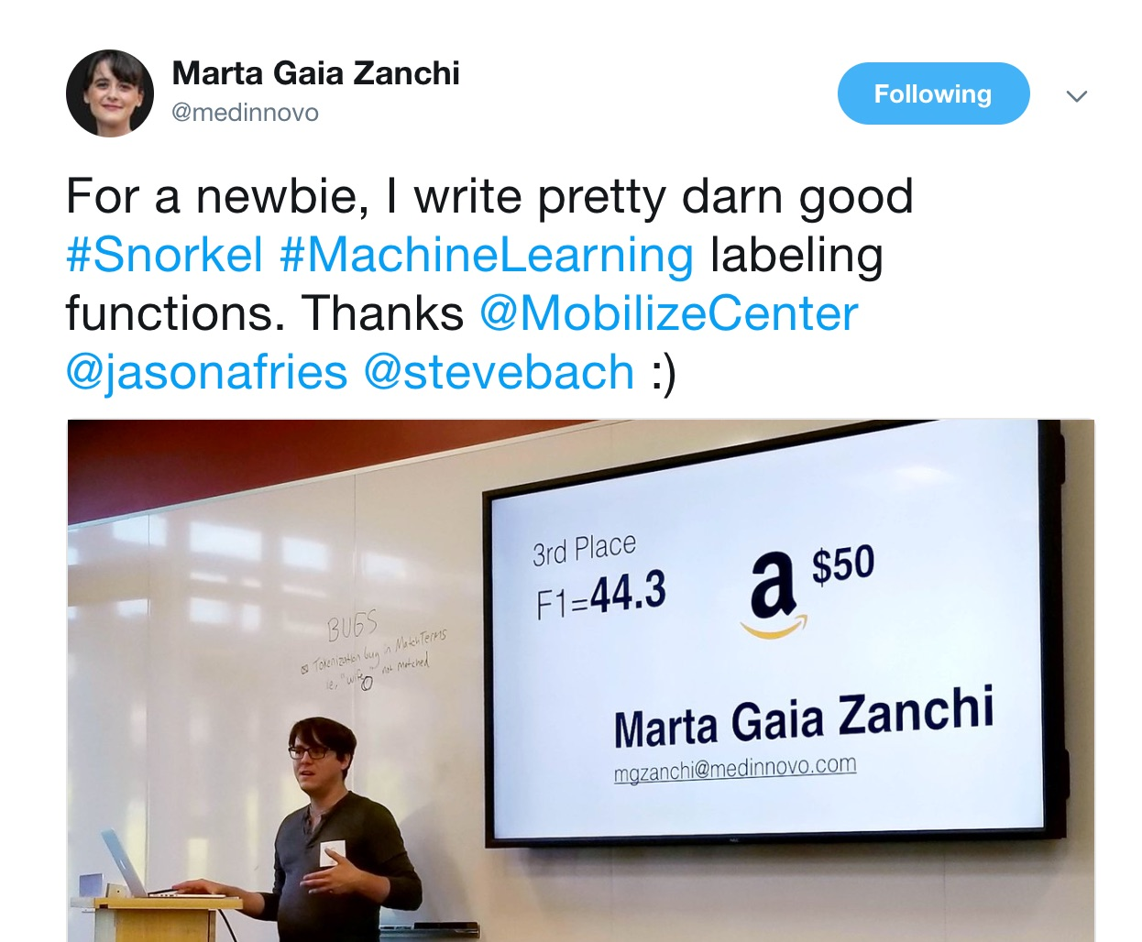
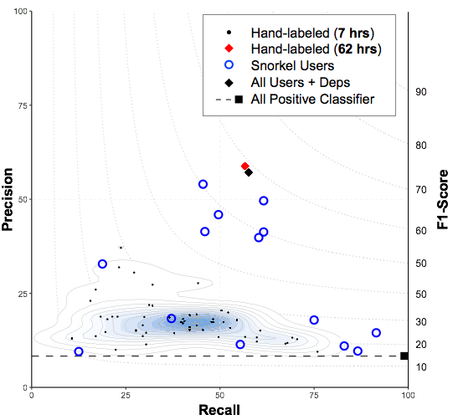
Jason Fries, Stephen Bach, Alex Ratner, Joy Ku, Christopher Ré
Snorkel User Study
We recently ran a Snorkel biomedical workshop in collaboration with the NIH Mobilize Center
15 companies and research groups attended
How well did these new Snorkel users do?
71%
New Snorkel users matched or beat 7 hours of hand-labeling
2.8x
Faster than hand-labeling data
45.5%
3rd Place Score
No machine learning experience
Beginner-level Python
Average improvement
in model performance

Slide 36
Conclusion
Snorkel provides a unifying framework for combining and modeling weak supervision
Allows us to rapidly generate training data for modern ML models
Labeling functions: supervision as code
For more check out snorkel.stanford.edu: Code, tutorials, blogs, papers
snorkel.stanford.edu

